Slide 1

Part 1
Common Programming Concepts

Slide 2

1.1 Variables and Mutability

Slide 3
Variables
Variables refer to memory locations in system that hold a value for that variable. This value can be changed during the execution of the program.
Variables are only valid in the scope in which they are declared.

Slide 4
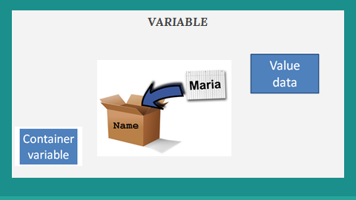

Slide 5
Types of Variable
Mutable Variables:
Variables whose value can be modified.
Immutable Variables:
Variables whose value cannot be modified.

Slide 6
In Rust, variables are immutable by default for safety. However we can change the mutability of variables.

Slide 7
Example:
Changing immutable variable
Result
This program will give a compile time error because we are trying to change the value of an immutable variable.
fn main() {
let x = 5;
println!("The value of x is: {}", x);
x = 6;
println!("The value of x is: {}", x);
}

Slide 8
Compilation / Compile time Error:
When a program fails to compile.

Slide 9
Example:
Changing mutable variable
Result:
The value of x is 5
The value of x is 6
fn main() {
let mut x = 5;
println!("The value of x is: {}", x);
x = 6;
println!("The value of x is: {}", x);
}

Slide 10
Constants
Constants are the values which are bound to a name and typically hold those values which we don’t want to change.
Constants are declared by using “const” keyword and the type of the value must be annotated.
Syntax:
const MAX_POINTS: u32 = 100_000;
:

Slide 11
Rust’s naming convention for constants is to use all uppercase with underscores between words.
Constants are used as hardcoded values which you want to use throughout your program.

Slide 12
Constants can be declared in any scope, including the global scope, which makes them useful for values that many parts of the code need to know about.
Example:
Speed of light
pi(π)

Slide 13
Shadowing
Shadowing is the declaration of a new variable with the same name as the previous variable, and the new variable shadows the previous variable.
A variable can be shadowed with a new type. E.g. String can be shadowed as an integer.

Slide 14
We can shadow a variable by using the same variable’s name and repeating the use of “let” keyword.

Slide 15
Example: Shadowing Variable
Result:
The value of x is 12
Note: Variable remains immutable.
fn main() {
let x = 5;
let x = x + 1;
let x = x * 2;
println!("The value of x is: {}", x);
}

Slide 16
Difference between Shadowing and Mutability
The difference between mut and shadowing is that because we’re effectively creating a new variable when we use the let keyword again, we can change the type of the value but reuse the same name.

Slide 17
We will get a compile-time error if we accidentally try to reassign value to an immutable variable without using the let keyword.
In shadowing, we can change the type of the value but reuse the same name.

Slide 18
Example:
Changing data type by shadowing
Note:
This will change the data type from string to integer.
let spaces = " ";
let spaces = spaces.len();

Slide 19
Example
Note:
By using ‘mut’ we are not allowed to change the data type of the variable.
let mut spaces = " ";
spaces = spaces.len();

Slide 20
1.2 Data Types

Slide 21
Data types:
Every value in Rust is of a certain data type.
Rust automatically infers primitive data type without explaining it explicitly.
Rust is a statically typed language, which means that it must knows the types of all variables at compile time.

Slide 22
Data types in RUST:
Scalar type A scalar type represents a single value. Rust has four primary scalar types.
Integer.
Floating-point.
Boolean.
Character.

Slide 23
Compound type Compound type can group multiple values into one type. Rust has two primitive compound types.
Tuples.
Arrays.

Slide 24
Scalar Types
Integer Type:
Length | Signed | Unsigned
8-bit | i8 | u8
16-bit | i16 | u16
32-bit | i32 | u32
64-bit | i64 | u64
arch | isize | usize

Slide 25
In Rust each integer can be either signed or unsigned and has an explicit size.
The isize and usize types depend on the kind of computer your program is running on: 64 bits if you’re on a 64-bit architecture and 32 bits if you’re on a 32-bit architecture.
If we do not declare type of an integer then Rust will by default take i32 for an integer.

Slide 26
Each signed variant can store numbers from -(2^{n - 1}) to 2^{n - 1} - 1 inclusive.
Unsigned variants can store numbers from 0 to 2^{n} - 1.
let variable: u32 = 100;
Data type

Slide 27
You can write integer literals in any of the forms given below
Number literals Example
Decimal 98_222
Hex 0xff
Octal 0o77
Binary 0b1111_0000
Byte (u8 only) b’A’

Slide 28
2) Floating-Point Types:
Rust also has two primitive types for floating-point numbers, which are numbers with decimal points.
Rust’s floating-point types are f32 and f64, which are 32 bits and 64 bits in size, respectively.

Slide 29
If we do not declare type of floating point then Rust will by default take f64 for that floating point type.
The f32 type is a single-precision float, and f64 has double precision.
let variable: f32 = 1.23;

Slide 30
3) Boolean Type:
A Boolean type in Rust has two possible values: true and false.
Booleans are one byte in size.

Slide 31
The Boolean type in Rust is specified using bool.
let variable: bool = true;

Slide 32
4) Character Type:
Rust supports letters too.
Rust’s char type is the language’s most primitive alphabetic type.

Slide 33
Characters are specified with single quotes, as opposed to string literals, which use double quotes.
Rust’s char type is four bytes in size and represents a Unicode Scalar Value.
let c = ‘z’;

Slide 34
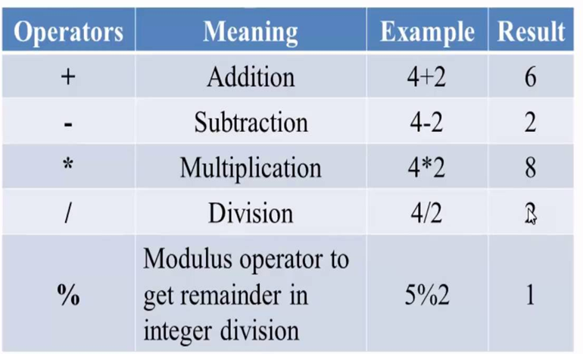
Numeric Operators:

Slide 35

Compound Type
Tuple Type:
A tuple is a general way of grouping together some number of other values with a variety of types.
Tuples have a fixed length, once declared, they cannot grow or shrink in size.
Contain heterogeneous data.

Slide 36
We create a tuple by writing a comma-separated list of values inside parentheses.
We can access a tuple element directly by using a period (.) followed by the index of the value we want to access.

Slide 37
Syntax:
declaration: let tup = (500, 6.4, 1);
Or
Let tup: ( i32 , f64 , u8) = (500 , 6.4 , 1) ;
Accessing a tuple element: let value1 = tup.0;

Slide 38
Example
Result:
The value of y is: 6.4
fn main() {
let tup = (500, 6.4, 1);
let (x, y, z) = tup;
println!("The value of y is: {}", y);
}
Note:
This way of assigning value is called destructuring

Slide 39

2) Array Type:
Another way to have a collection of multiple values is with an array.
Contains homogenous data.
Every element of an array must have the same type not like a Tuple.

Slide 40
Writing an array's type is done with square brackets containing the type of each element in the array followed by a semicolon and the number of elements in the array.
You can access elements of an array using indexing in square bracket.

Slide 41
An array isn’t flexible and not allowed to grow or shrink in size.
declaration: let array = [1, 2, 3, 4, 5];
Accessing an array element: let value1 = array[0];

Slide 42
Example
fn main() {
let a = [1, 2, 3, 4, 5];
let element = 3;
println!("The value of element is: {}", a[element]);
}
Result:
The value of element is: 4

Slide 43
1.3 FUNCTION

Slide 44
FUNCTION
“fn” keyword allows you to declare new functions.
Rust code uses snake case as the conventional style for function and variable names.
In snake case, all letters are lowercase and underscores separate the words.

Slide 45
Example
fn main() {
println!("Hello, world!");
another_function();
}
fn another_function() {
println!("Another function.");
}
Result:
Hello, world
Another function.
Note: Rust doesn’t care where you define your functions after or before the main function

Slide 46
Function Parameters
These are the special variables that are part of a function’s signature.
When a function has parameters, you can provide it with concrete values for those parameters

Slide 47
Technically, the concrete values are called arguments
But in casual conversation, you can use both i.e parameter or argument
While calling a function, function’s parameter value has to be set.

Slide 48
Example
Result:
The value of x is: 5
fn main() {
another_function(5);
}
fn another_function(x: i32) {
println!("The value of x is: {}", x);
}
In function’s signature, you must declare the type of each parameter.

Slide 49
Example
Result:
The value of x is: 5
The value of y is: 6
fn main() {
another_function(5, 6);
}
fn another_function(x: i32, y: i32) {
println!("The value of x is: {}", x);
println!("The value of y is: {}", y); }
Note
The function’s parameters don’t all need to be the same type.
Multiple parameters can be separated by commas.

Slide 50
Statements and Expressions
Rust is an expression-based language
Function bodies are made up of series of statements optionally ending in an expression.

Slide 51
Statements are instructions that perform some action and do not return a value.
● Expressions evaluate to a resulting value.

Slide 52
Creating a variable and assigning a value to it with the let keyword is an statement.
The let y = 6 statement does not return a value
Note: Statement contains (;) at its end.
fn main() {
let y = 6;
}

Slide 53

Consider a simple math operation, such as 5 + 6, which is an expression that evaluates to the value 11.
Expressions can be part of statements
Note: Expression does not contain (;) at its end.
fn five() i32 {
5
}

Slide 54
Example
Result:
The value of y is: 4
fn main() {
let x = 5;
let y = {
let x = 3;
x + 1
};
println!("The value of y is: {}", y);
}
Note: x+1 is an expression without semicolon. If you add a semicolon to the end of an expression, you turn it into an statement, which will then not return a value.

Slide 55
FUNCTION WITH RETURN VALUE
Functions can return values to the code that calls them. We don’t name return values, but we do declare their type after an arrow ( ).

Slide 56
Example
Result:
The value of x is: 5
Note: We can’t use semicolon(;) after 5 because it is an expression.
fn five() i32 {
5
}
fn main() {
let x = five();
println!("The value of x is: {}", x);
}

Slide 57
1.4 Comments

Slide 58
Comments
Comment makes code easy to understand when some time extra explanation is warranted.
Compiler will ignore to compile the comments in code but people reading the source code may find it useful.

Slide 59
Comments must start with two slashes and continue until the end of the line.
For comments that extend beyond a single line, you’ll need to include // on each line.

Slide 60
Examples: Comments
fn main() {
// hello
// hi
// hey
}
fn main() {
// hello, world
}

Slide 61
1.5 Control Flow

Slide 62
Control Flow
A control flow is the order in which the piece of program is executed.
In control flow we have following expressions:
If expression
Else expression
Else if expression

Slide 63
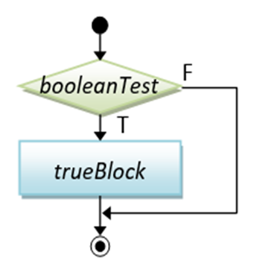
If Expression:
If expression allows to branch your code to any condition.
If the condition is true then the program in if block will be executed.

Slide 64
When if expression is not true then the program will be passed to further blocks of else if expressions or else expression.
The curly brackets defining the program blocks are called arms.

Slide 65
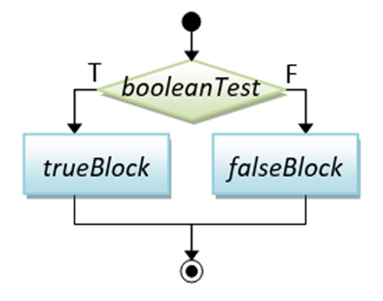
Else Expression:
Else expression gives the program an alternative block of code to execute when the condition introduced in if block evaluates to false.
Else expression comes at last.

Slide 66
Example
fn main() {
let number = 3;
if number < 5 {
println!("condition was true");
} else {
println!("condition was false");
}
}
Result:
Condition was true

Slide 67
Example
fn main() {
let number = 7;
if number < 5 {
println!("condition was true");
} else {
println!("condition was false");
}
}
Result:
Condition was false

Slide 68
Note:
The condition introduced in if expression and else if expression should be bool type (true or false) . Otherwise the program will not run.
Rust will not automatically try to convert non-Boolean types to a Boolean.

Slide 69
Example
Result:
Compile time error occur
Note: Here Rust will give error because instead of giving a bool condition we have placed an integer in condition.
fn main() {
let number = 3;
if number {
println!("number was something other than zero");
}
}

Slide 70
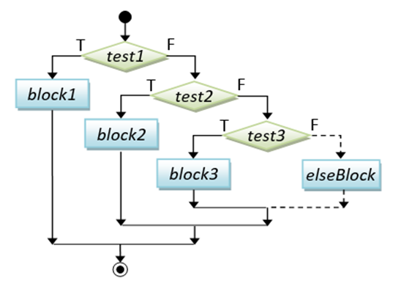
Else If Expression:
Else if expression is used to introduce multiple conditions.
This expression is always situated between if expression and else expression

Slide 71
Example
fn main() {
let number = 6;
if number % 4 == 0 {
println!("number is divisible by 4");
} else if number % 3 == 0 {
println!("number is divisible by 3");
} else if number % 2 == 0 {
println!("number is divisible by 2");
} else {
println!("number is not divisible by 4, 3, or 2");
} }
Result:
Number is divisible by 4

Slide 72
Note:
In the above example there are two true conditions but Rust print the block of first true condition.
Which means Rust only executes the block of first true condition.

Slide 73
Using if in let statement
We can use if expression to store different values depending upon the condition in variable using let statement , as mentioned in next example.

Slide 74
Example
fn main() {
let condition = true;
let number = if condition {
5 // (no semicolon means expression)
} else {
6 // (no semicolon means expression)
};
println!("The value of number is: {}", number);
}
Note:
Value of 5 will be stored in the number variable.

Slide 75
Example
Result:
Compile error will occur
Note: Expression types are mismatched in each arm, hence an error will be occured.
fn main() {
let condition = true;
let number = if condition {
5
} else {
"six"
};
println!("The value of number is: {}", number);
}

Slide 76
Loops:
Loops execute a block of code more than once.
Types of loops
loop
while
for

Slide 77
loop
The loop keyword tells Rust to execute a block of code over and over again forever or until you explicitly tell it to stop.
‘break’ expression can be use to stop the loop and the value is placed after the break expression that we want in return.

Slide 78
Example
Result:
again!
again!
again!
again!
(and so on …..)
fn main() {
loop {
println!("again!");
}
}

Slide 79
Example
fn main() {
let mut counter = 0;
let result = loop {
counter += 1;
if counter == 10 {
break counter * 2;
}
};
println!("The result is {}", result); }
Result:
Here 20 will be save in the result variable

Slide 80
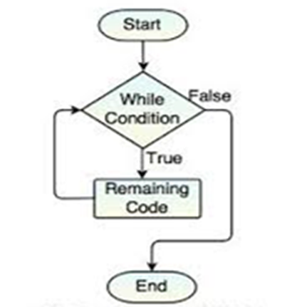
2. While loop
In this type of loop While the condition is true, the loop runs. When the condition ceases to be true, the program calls break, stopping the loop.

Slide 81
Example
Result:
3!
2!
1!
LIFTOFF!!!
fn main() {
let mut number = 3;
while number != 0 {
println!("{}!", number);
number = number - 1;
}
println!("LIFTOFF!!!");
}

Slide 82
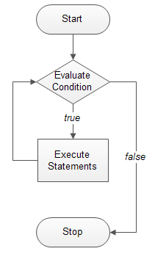
3. For loop
loops through a block of code a number of times(iteration)

Slide 83
Example
Result:
the value is: 10
the value is: 20
the value is: 30
the value is: 40
the value is: 50
fn main() {
let a = [10, 20, 30, 40, 50];
for element in a.iter() {
println!("the value is: {}", element);
}
}

Slide 84
Note:
iter() is used for iteration.

Slide 85
Example
fn main() {
for number in (1..4).rev() {
println!("{}!", number);
}
println!("LIFTOFF!!!");
}
Result:
3!
2!
1!
LIFTOFF!!!

Slide 86
Note:
(1..4) is for declaring range.
rev() is used for reverse order

Slide 87
Section Break

Slide 88
Part 2
Understanding Ownership

Slide 89
As a programming language
C/C++
Haskell/Python
more control,
less safety
less control,
more safety
Rust
more control,
more safety
No need for runtime
Memory safety
Data race freedom

Slide 90
Section 2.1
Ownership

Slide 91
What you will learn ...
Ownership Concept
Concept of Stack
Ownership Rules
String Type
Memory Allocation
Ownership and Functions

Slide 92
Memory and Allocation
In Rust, data can be stored either in stack or heap memory.
Memory Types
Stack Memory
Heap Memory

Slide 93
Stack and Heap
Both are parts of memory to be used at runtime, but they are structured in different ways.

Slide 94
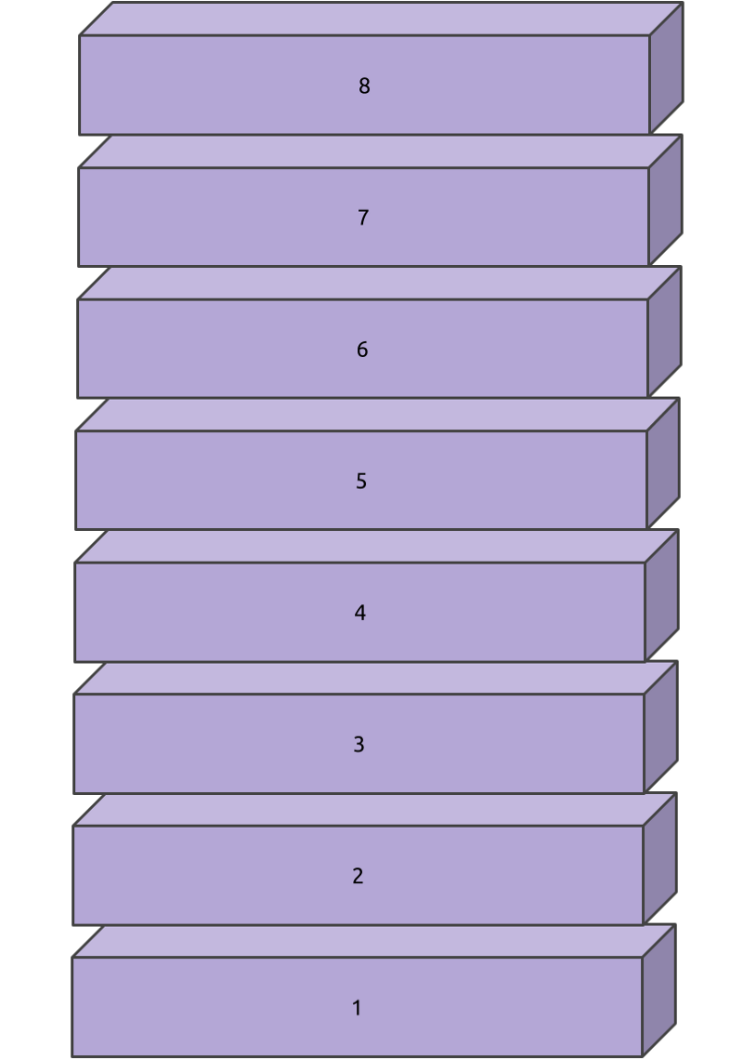
Stack
It stores values in the order it gets them and removes the values in the opposite order.
Referred to as Last In, First Out (LIFO).

Slide 95

Stack: Think of a stack of plates
When you add more plates, you put them on top of the pile, and when you need a plate, you take one off the top.
Adding or removing plates from the middle or bottom wouldn’t work as well!

Slide 96
Stack
Adding data is called pushing onto the stack,
Removing data is called popping off the stack.
Stack memory is an organized memory.
It is faster than the heap memory because of the way it accesses the memory.
All data stored on the stack must have a known, fixed size

Slide 97
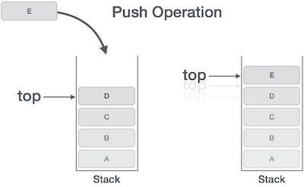
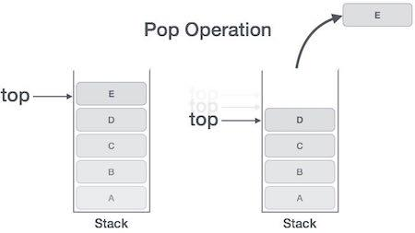
Stack Push and Pop Example:

Slide 98
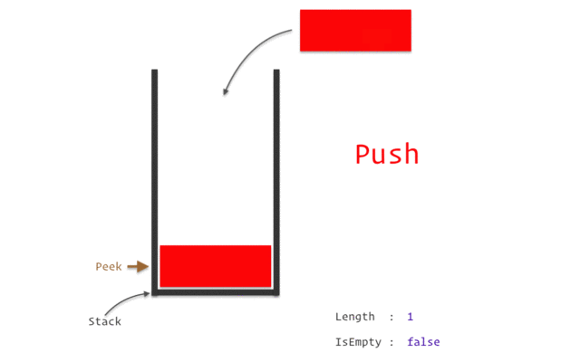
Stack: in action

Slide 99
Stack: How it works
When code calls a function, the values passed into the function (including, potentially, pointers to data on the heap) and the function’s local variables get pushed onto the stack.
When the function is over, those values get popped off the stack.

Slide 100
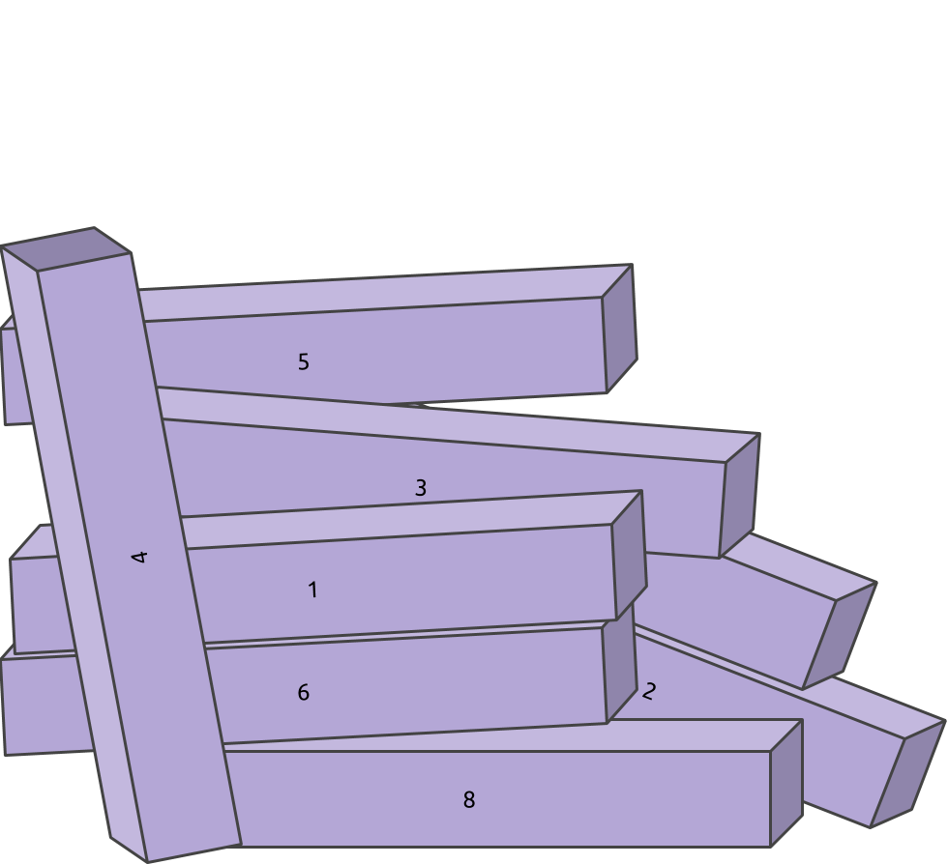
Heap
The Heap is Less Organized
Data with a size that is unknown at compile time or a size that might change must be stored on the heap.

Slide 101
Heap: Allocation
When you put data on the heap, you ask for some amount of space from OS.
The operating system finds an empty spot in the heap that is big enough, marks it as being in use, and returns a pointer, which is the address of that location.

Slide 102
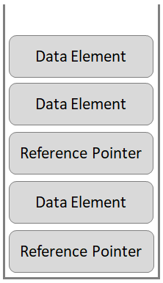
Heap
Hello World!
PIAIC
The quick brown fox jumps over the lazy dog.
The name of my country is Pakistan.
Rust
Example
Stack
Heap
(Organised)
(Haphazard)

Slide 103

Heap: Restaurant as Example

Slide 104

Heap
Less organized
Requested from OS
Slower
Follow pointer
large amount... take time to manage data in the heap

Slide 105
Why pushing to the stack is faster than allocating on the heap ?
Because the operating system never has to search for a place to store new data; that location is always at the top of the stack.

Slide 106
Why accessing data in the heap is slower than on the stack ?
Allocating space on the heap requires more work, because you ask for some amount of space to operating system every time.
OS has to follow a pointer every time.

Slide 107
Ownership
All programs have to manage the way they use a computer’s memory while running.

Slide 108
Ownership
Some languages have garbage collection that constantly looks for no longer used memory as the program runs.
In other languages, the programmer must explicitly allocate and free the memory.

Slide 109
Ownership
Rust uses a third approach wherein memory is managed through a system of ownership
Ownership is managed with a set of rules that the compiler checks at compile time.
None of the ownership features slow down your program while it’s running.

Slide 110
Ownership
In simple words for understanding purpose……
Ownership is the transfer of currently possessed entity to another party which causes the previous owner to no longer have access to the object that is being transferred.

Slide 111
Ownership
In Rust, there are very clear rules about which piece of code owns a resource.
In the simplest case, it’s the block of code that created the object representing the resource.
At the end of the block the object is destroyed and the resource is released.

Slide 112
Ownership
fn main() {// s is not valid here, it’s not yet declared let s = "hello"; // s is valid from this point forward // do stuff with s println!("{}", s); }// this scope is now over, and s is no longer valid
In the above example the letter or variable “s” is the owner of the word “hello” and is valid from the point of declaration after the start of the parenthesis “{“ and remains valid until the end of the parenthesis “}”.

Slide 113
Why Ownership
Ownership is Rust’s most unique feature, and it enables Rust to make memory safety guarantees without needing a garbage collector.

Slide 114
Why Ownership
Keeping track of what parts of code are using what data on the heap, minimizing the amount of duplicate data on the heap, and cleaning up unused data on the heap so you don’t run out of space are all problems that ownership addresses.

Slide 115
Why Ownership
All primitive data types (integers, booleans, string literals) and pointers (address of heap data) are stored on stack whereas for more complicated data types we have heap.

Slide 116
Ownership Rules

Slide 117
Rule # 1
Each value in Rust has a variable that’s called its Owner.

Slide 118
Rule # 1 Example
Each value in Rust has a variable that’s called its owner.
let a = “Hello world!”;
Variable
Value
In the above example the variable i.e. “a” is also the owner of the value “Hello world!”.

Slide 119
Rule # 2
There can only be one owner at a time.

Slide 120
Rule # 2 Example
Each value in Rust has a variable that’s called its owner.
let a = String::from(“Hello”); –> here variable “a” is the owner
let b = a; –> here the value of “a” is moved to variable “b” which now becomes the owner of “Hello”
Considering both variables “a” and “b” are within the same scope.

Slide 121
Rule # 3
When the owner goes out of scope, so does the value.

Slide 122
Rule # 3 Example
When the owner goes out of scope, so does the value.
fn main() {
{ –> “a” is not valid here, it’s not yet declared
let a = “Hello"; –> “a” is valid from this point forward
–> do stuff with “a”
} –> this scope is now over and “a” is no longer valid
}

Slide 123
Variable Scope
A scope is the range within a program for which an item is valid.
When variable comes into scope, it is valid. It remains valid until it goes out of scope.

Slide 124
Variable Scope
fn main()
{// s is not valid here, it’s not yet declared
let s = "hello"; // s is valid from this point forward // do stuff with s println!("{}", s);
}// this scope is now over, and s is no longer valid

Slide 125
Variable Scope
The variable “s” refers to a string literal, where the value of the string is hardcoded into the text of our program. The variable is valid from the point at which it’s declared until the end of the current scope.
When “s” comes into scope, it is valid.
It remains valid until it goes out of scope

Slide 126
The String Type
Rust has a second string type, String.
This type is allocated on the heap and is able to store an amount of text that is unknown to us at compile time.

Slide 127
The String Type
You can create a String from a string literal using the from function, like: let s = String::from("hello");
The double colon (::) is an operator that allows us to namespace this particular from function under the String type rather than using some sort of name like string_from.

Slide 128
The String Type
This kind of string can be mutated:
let mut s = String::from("hello"); s.push_str(", world!"); // appends a literal to a String println!("{}", s); // This will print `hello, world!`
The difference between String Literal and String type is how these two types deal with memory.

Slide 129
String: Memory
and Allocation
The memory must be requested from the OS* at runtime.
Rust automatically calls drop function to return memory when variable goes out of scope.
*OS = Operating System

Slide 130
String: Memory and Allocation
1
2
3
Call String::from
It requests the memory it needs
Drop returns memory automatically

Slide 131
Ways Variables
And
Data Interact:

Slide 132
Move
This is binding the value 5 to x; then make a copy of the value in x and binding it to y.”
We now have two variables, x and y, and both equal 5 and valid.
fn main() {
let x = 5;
let y = x;
}

Slide 133
Move
fn main() {
let s1 = String::from("hello");
let s2 = s1;
}
Looks familiar ? But not quite …
In this value of s1 is moved to s2

Slide 134
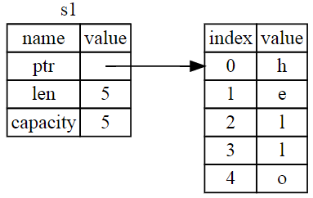
Move
A String consists of three parts, shown on the left:
a pointer to the memory on the heap, a length, and a capacity.
These are stored on the stack.
On the right is the memory on the heap that holds the contents.
Fig: Representation in memory

Slide 135
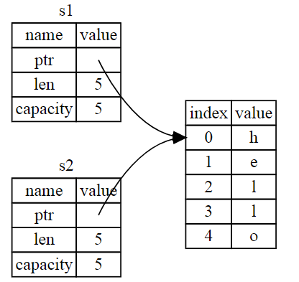
Move
When we assign s1 to s2, the String data on stack is copied i.e. the pointer, the length, and the capacity
Data on the heap is not copied
Fig: Representation in memory

Slide 136
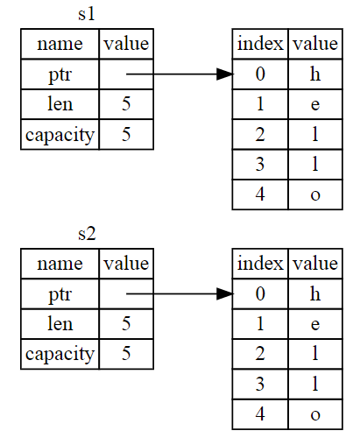
Move
Operation s2 = s1 could be very expensive in terms of runtime performance if the data on the heap were large.
Fig: Representation in memory

Slide 137
Move
Drop function is called when a variable goes out of scope
This is a problem: when s2 and s1 go out of scope, they will both try to free the same memory.
This is known as a double free error.
Freeing memory twice can lead to memory corruption.

Slide 138
Move
Instead of trying to copy the allocated memory, Rust considers s1 to no longer be valid and, therefore, Rust doesn’t need to free anything when s1 goes out of scope.
Fig: Representation in memory

Slide 139

Move
You’ll get an error because Rust prevents you from using the invalidated reference
fn main() {
let s1 = String::from("hello");
let s2 = s1;
println!("{}, world!", s1);
}

Slide 140
Move
error[E0382]: use of moved value: `s1`
--> src/main.rs:5:28
|
3 | let s2 = s1;
| -- value moved here
4 |
5 | println!("{}, world!", s1);
| ^^ value used here after move
|
= note: move occurs because `s1` has type `std::string::String`, which does
not implement the `Copy` trait

Slide 141
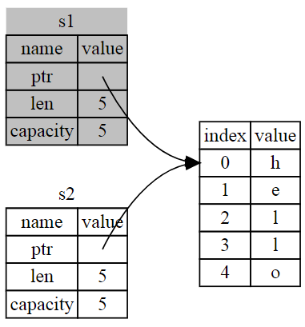
Move
This differs from shallow copy as Rust also invalidates the first variable, instead it’s known as a move.
In this example, we would say that s1 was moved into s2.
Fig: Representation in memory

Slide 142
Clone
fn main() {
let s1 = String::from("hello");
let s2 = s1.clone();
println!("s1 = {}, s2 = {}", s1, s2);
}
If we do want to deeply copy the heap data of the String, not just the stack data, we can use a common method called clone.
This works just fine and explicitly produces the behavior, the heap data does get copied.

Slide 143
Stack Only Data: Copy
We don’t have a call to clone, but x is still valid and wasn’t moved into y.
Reason such types like integers
have known size at compile time
are stored entirely on the stack, so copies are quick to make.
fn main()
{
let x = 5;
let y = x;
println!("x = {}, y = {}", x, y);}

Slide 144
Stack Only Data: Copy
So what types are Copy?
All integer
Boolean
All floating point
Character
Tuples, if they contain types that are also Copy. i.e
(i32, i32) is Copy,
(i32, String) is not.

Slide 145
Ownership & Function

Slide 146
Ownership & Function
The concept of ownership in a function is as same as the assigning a value to a variable.
Assigning a value to a function will take it ownership and you would not be able to reuse it

Slide 147
Ownership & Function
fn main() {
let s = String::from("hello");
takes_ownership(s);
let x = 5;
makes_copy(x);
}
fn takes_ownership(some_string: String) {
println!("{}", some_string);
}
fn makes_copy(some_integer: i32) {
println!("{}", some_integer);
}

Slide 148
Ownership & Function
fn main() {
let s = String::from("hello");
takes_ownership(s);
let x = 5;
makes_copy(x);
}
“s” value moves into the function
“takes_ownership()”
...and so is no longer valid after this
“s” comes into scope
“x” comes into scope
“x” would move into the function
makes_copy()
but i32 is “Copy”, so can be
used afterwards
Here, x goes out of scope, then s. But because s's value was moved, nothing special happens.
Notes:
If we tried to use s after the call to takes_ownership, Rust would throw a compile-time error. These static checks protect us from mistakes. Try adding code to main that uses s and x to see where you can use them and where the ownership rules prevent you from doing so.

Slide 149
Ownership & Function
fn takes_ownership(some_string: String) {
println!("{}", some_string);
}
fn makes_copy(some_integer: i32) {
println!("{}", some_integer);
}
“some_string” comes into scope
Drop is called and “some_string” goes out of scope.
some_integer comes into scope
“some_integer” goes out of scope. Nothing special happens.
Notes:
If we tried to use s after the call to takes_ownership, Rust would throw a compile-time error. These static checks protect us from mistakes. Try adding code to main that uses s and x to see where you can use them and where the ownership rules prevent you from doing so.

Slide 150
Returning values and scope
Returning a value in a function also transfer the ownership
Whenever a function return a value the ownership is also returned.

Slide 151
Returning values and scope
fn main() {
let s1 = gives_ownership();
let s2 = String::from("hello");
let s3 = takes_and_gives_back(s2);
}
fn gives_ownership() -> String {
let some_string = String::from("hello");
some_string
}
fn takes_and_gives_back(a_string: String) -> String {
a_string
}

Slide 152
Return Values and Scope
fn main() {
let s1 = gives_ownership();
let s2 = String::from("hello");
let s3 = takes_and_gives_back(s2);
}
gives_ownership moves its return value into s1
s2 comes into scope
s2 is moved into takes_and_gives_back, which also moves its return value into s3
Here, s3 goes out of scope and is dropped. s2 goes out of scope but was moved, so nothing happens. s1 goes out of scope and is dropped.

Slide 153
Return Values and Scope
fn gives_ownership() -> String {
let some_string = String::from("hello");
some_string
}
gives_ownership will move its return value into the function that calls it
some_string is returned and moves out to the calling function
some_string comes into scope
Here, some_string goes out of scope but was moved, so nothing happens.

Slide 154
Return Values and Scope
fn takes_and_gives_back(a_string: String) -> String {
a_string
}
takes_and_gives_back will take a String and return one
a_string come into scope
a_string is returned and moves out to the calling function
Here, a_string goes out of scope but was moved, so nothing happens.

Slide 155
Return Multiple Values
fn main() {
let s1 = String::from("hello");
let (s2, len) = calculate_length(s1);
println!("The length of'{}'is{}.",s2,len);
}
fn calculate_length(s: String)->(String,usize)
{ let length = s.len();
(s, length)
}
s1 is moved into calculate_length, which also moves its return value into tuple (s2,len)
(s, length) is returned and moves out to the calling function
len() returns the length of a String
Notes:
It’s possible to return multiple values using a tuple.
But this is too much ceremony and a lot of work for a concept that should be common. Luckily for us, Rust has a feature for this concept, called references.

Slide 156
Section 2.2
Borrowing and Referencing

Slide 157
What you will learn
Borrowing
References
Mutable References
Data Race
Rules of References
Dangling Reference

Slide 158
What is Borrowing?

Slide 159
Borrowing
We call having references as function parameters borrowing. As in real life, if a person owns something, you can borrow it from them. When you’re done, you have to give it back.

Slide 160
What is Referencing?

Slide 161
Referencing
Reference is the act of consulting someone or something in order to get information
In terms of Rust programing we can define reference as if we are taking a copy of it without damaging or taking its ownership

Slide 162
Referencing
‘&’ symbol is used to pass the reference

Slide 163
Referencing
Let’s have a look how ‘&’ symbol is used in code.

Slide 164
Referencing
fn main() {
let s1 = String::from("hello");
let len = calculate_length(&s1);
println!("The length of {} is {}.", s1, len);
}
fn calculate_length(s: &String) -> usize {
s.len()}

Slide 165
Mutable References

Slide 166
Mutable References
The concept of mutable reference is same as we use mutable variable
Mutable reference is used when we have to modify the value we make reference to

Slide 167
Mutable References
There should be “mut” keyword with the reference as well as the variable or type we are making reference.

Slide 168
fn main() {
let s = String::from("hello");
change(&s);}
change(some_string: &String) {
some_string.push_str(", world");
}
If we try to run this code, we will get an error because references are immutable by default in Rust.

Slide 169
We can fix that error by adding ‘mut’ keyword
fn main() { let mut s = String::from("hello"); change(&mut s); }
fn change(some_string: &mut String) {
some_string.push_str(", world");
}

Slide 170
Restriction!
But Mutable References have one big restriction
You can have only one mutable reference to a particular piece of data in a particular scope.

Slide 171

For Example:
For Example:
For Example:
let mut s = String::from("hello");
let r1 = &mut s;
let r2 = &mut s;
println!("{}, {}", r1, r2);
let mut s = String::from("hello");
let r1 = &mut s;
let r2 = &mut s;
println!("{}, {}", r1, r2);
let mut s = String::from("hello");
let r1 = &mut s;
let r2 = &mut s;
println!("{}, {}", r1, r2);
Duplicate
Duplicate
Duplicate
This is not allowed.

Slide 172
Restriction Benefit
The benefit of having this restriction is that Rust can prevent Data Race at compile time.

Slide 173
Data Race
Occurs when,
Two or more pointers access the same data at the same time.
At least one of the pointers is being used to write to the data.
There’s no mechanism being used to synchronize access to the data.

Slide 174
Data Race
fn main() {
let mut s = String::from("hello");
{
let r1 = &mut s;
}
let r2 = &mut s;
}
r1 goes out of scope here, so we can make a new reference with no problems.

Slide 175
Data Race
fn main() {
let mut s = String::from("hello");
let r1 = &s;
let r2 = &s;
let r3 = &mut s;
println!("{}, {}, and {}", r1, r2, r3);
}
no problem
no problem
BIG PROBLEM

Slide 176
Data Race
error[E0502]: cannot borrow `s` as mutable because it is also borrowed as immutable
--> src/main.rs:6:14
|
4 | let r1 = &s;
| -- immutable borrow occurs here
5 | let r2 = &s;
6 | let r3 = &mut s;
| ^^^^^^ mutable borrow occurs here
7 |
8 | println!("{}, {}, and {}", r1, r2, r3);
| -- immutable borrow later used here

Slide 177
Data Race
Data races cause undefined behavior and can be difficult to diagnose and fix when you’re trying to track them down at runtime; Rust prevents this problem from happening because it won’t even compile code with data races!

Slide 178
Dangling References
Dangling pointer that references a location in memory that may have been given to someone else
In Rust the compiler will ensure that the data will not go out of scope before the reference to the data does.

Slide 179
Dangling References
fn main() {
let reference_to_nothing = dangle();
}
fn dangle() -> &String {
let s = String::from("hello");
&s
}

Slide 180
Dangling References
error[E0106]: missing lifetime specifier
--> main.rs:5:16
|
5 | fn dangle() -> &String {
| ^ expected lifetime parameter
|
= help: this function's return type contains a borrowed value, but there is
no value for it to be borrowed from
= help: consider giving it a 'static lifetime

Slide 181
Dangling References
fn dangle() -> &String {
let s = String::from("hello");
&s
}
dangle returns a reference to a String
s is a new String
we return a reference to the String, s
Here, s goes out of scope, and is dropped. Its memory goes away. Danger!
Notes:
Because s is created inside dangle, when the code of dangle is finished, s will be deallocated. But we tried to return a reference to it. That means this reference would be pointing to an invalid String. That’s no good! Rust won’t let us do this.

Slide 182
Dangling References
fn dangle() -> String {
let s = String::from("hello");
s
}
Notes:
The solution here is to return the String directly:
This works without any problems. Ownership is moved out, and nothing is deallocated.

Slide 183
Rules of
References
There can either be one mutable reference or any number of immutable references.
References must always be valid.

Slide 184
Summary
Ownership and borrowing ensure memory safety at compile time.
Control over your memory usage in the same way as other systems programming languages

Slide 185
Summary
Automatically clean up that data when the owner goes out of scope.
No extra code to get this control.

Slide 186
Section Break

Slide 187

Part 3
Structs for Structure Related Data

Slide 188
Contents:
To be able to describe STRUCT in Rust Language
To be able to read and write syntax
To be able to define STRUCTS and manipulate in Rust
Methods syntax and its application
To be able to describe the concept of TRAITS in Rust
To be able to implement TRAITS in Rust Language

Slide 189
Introduction to Struct
A struct, or structure, is a custom data type that lets you name and package together multiple related values that make up a meaningful group.
Under the light of OOP concept , a struct is like an object’s data attributes.
Structs are the building blocks for creating new types in your program’s domain to take full advantage of Rust’s compile time type checking.

Slide 190
Defining Struct
Structs are similar to tuples.
Like tuples, the pieces of a struct can be different types.
Thing which distinguish struct from tuple is that, we can name each piece of data so it’s clear what the values mean.

Slide 191
Defining Struct
struct User {
username: String,
email: String,
sign_in_count:u64,
active: bool,
}
keyword
Name: should describe the significance of the pieces of data being grouped together
Fields: define the names and types of the pieces of data

Slide 192
structs are more flexible than tuples:
you don’t have to rely on the order of the data to specify or access the values of an instance

Slide 193
Instantiating Struct
We create an instance by stating the name of the struct and then add curly brackets containing key: value pairs, where the keys are the names of the fields and the values are the data we want to store in those fields.
let user1 = User {
email: String::from("someone@example.com"),
username: String::from("someusername123"),
active: true,
sign_in_count: 1,
};
Instance:
struct by specifying concrete values for each of the fields.

Slide 194
To get a specific value from the struct, we can use dot notation.
user1.email = String::from("anotheremail@example.com");

Slide 195
Field Init Shorthand
For variable with the same name as struct field, you can use “field init shorthand”
struct User {
username: String,
email: String,
sign_in_count:u64,
active: bool,
}
Consider the same User Struct

Slide 196
Field Init Shorthand
fn build_user(email: String, username: String) -> User {
User {
email: email,
username: username,
active: true,
sign_in_count: 1,
}
}
field init shorthand
fn build_user(email: String, username: String) -> User {
User {
email,
username,
active: true,
sign_in_count: 1,
}
}

Slide 197
Creating Instances From Other Instances With Struct Update Syntax
It’s often useful to create a new instance of a struct that uses most of an old instance’s values but changes some.
# struct User {
# username: String,
# email: String,
# sign_in_count: u64,
# active: bool,
# }
let user1 = User {
# email: String::from("someone@example.com"),
# username: String::from("someusername123"),
# active: true,
# sign_in_count: 1,
# };
let user2 = User {
email: String::from("another@example.com"),
username: String::from("anotherusername567"),
active: user1.active,
sign_in_count: user1.sign_in_count,
};
# struct User {
# username: String,
# email: String,
# sign_in_count: u64,
# active: bool,
# }
let user1 = User {
# email: String::from("someone@example.com"),
# username: String::from("someusername123"),
# active: true,
# sign_in_count: 1,
# };
let user2 = User {
email: String::from("another@example.com"),
username: String::from("anotherusername567"),
..user1,
};

Slide 198
Tuple Structs without Named Fields to Create Different Types
Tuple structs have the added meaning the struct name provides but don’t have names associated with their fields; rather, they just have the types of the fields.
struct Color(i32, i32, i32);
struct Point(i32, i32, i32);
let black = Color(0, 0, 0);
let origin = Point(0, 0, 0);
Note: the ”black” and ”origin” values are different types, because they’re instances of different tuple structs. Each struct we define is its own type, even though the fields within the struct have the same types.
For example, a function that takes a parameter of type Color cannot take a Point as an argument, even though both types are made up of three i32 values. Otherwise, tuple struct instances behave like tuples.

Slide 199
Ownership of Struct Data
In the User struct definition, we used the owned String type rather than the &str string slice type.
This is a deliberate choice because we want instances of this struct to own all of its data and for that data to be valid for as long as the entire struct is valid.
It’s possible for structs to store references to data owned by something else, but to do so requires the use of lifetimes.

Slide 200
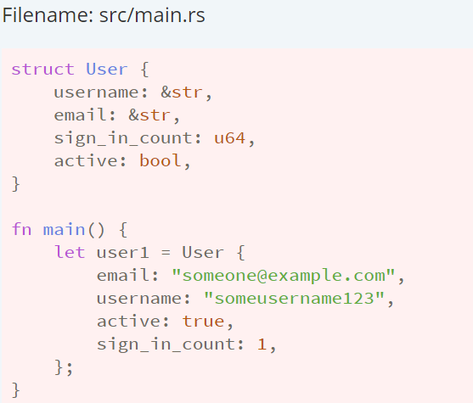
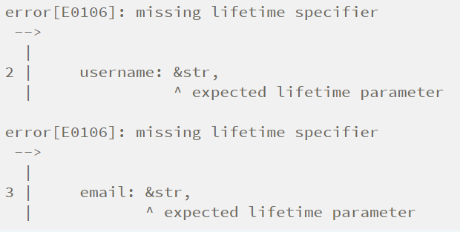
Let’s say you try to store a reference in the struct without specifying lifetimes, like this, it won’t work:
The compiler will complain that it needs lifetime specifiers:

Slide 201
An Example Program Using Structs

Slide 202
Let’s write a program that calculates the area of a rectangle.
We’ll start with single variables, and then refactor the program until we’re using structs instead.
Those structs will take the width and height of a rectangle specified in pixels and calculate the area of the rectangle.
Listing 5-8 shows a short program with one way of doing exactly that in our project’s src/main.rs.

Slide 203
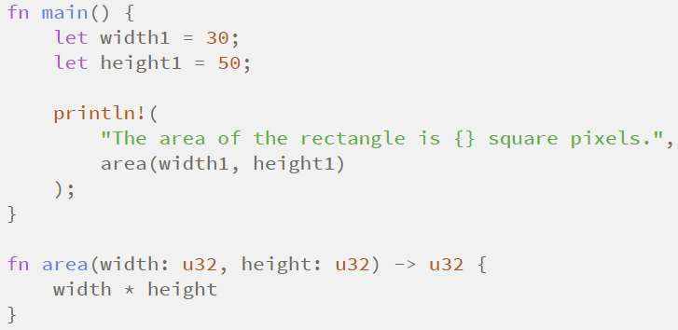
Listing 5-8: Calculating the area of a rectangle specified by separate width and height variables

Slide 204
The issue with this code is evident in the signature of area :
The area function is supposed to calculate the area of one rectangle, but the function we wrote has two parameters.
The parameters are related, but that’s not expressed anywhere in our program.
It would be more readable and more manageable to group width and height
together.

Slide 205
Refactoring with Tuples
In one way, this program is better. Tuples let us add a bit of structure, and we’re now passing just one argument.
Tuples don’t name their elements, so our calculation has become more confusing because we have to index into the parts of the tuple.
It doesn’t matter if we mix up width and height for the area calculation, but if we want to draw the rectangle on the screen, it would matter! We would have to keep in mind that width is the tuple index 0 and height is the tuple index 1.

Slide 206
Refactoring with Structs: Adding More Meaning
We use structs to add meaning by labeling the data. We can transform the tuple we’re using into a data type with a name for the whole as well as names for the parts, as shown in Listing 5-10.
Our area function is now defined with one parameter, which we’ve named rectangle , whose type is an immutable borrow of a struct Rectangle instance.
We want to borrow the struct rather than take ownership of it.

Slide 207
Defining a Rectangle struct
This way, main retains its ownership and can continue using rect1 , which is the reason we use the & in the function signature and where we call the function.
The area function accesses the width and height fields of the Rectangle instance.
This conveys that the width and height are related to each other, and it gives descriptive names to the values rather than using the tuple index values of 0 and 1 .
7) This is a win for clarity.

Slide 208
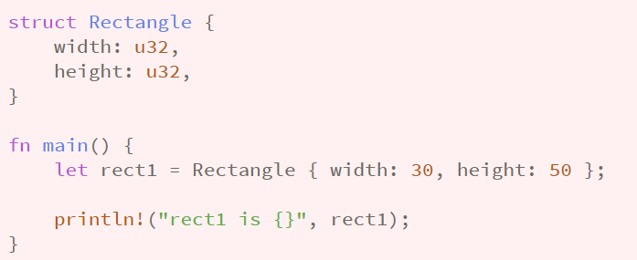
Adding Useful Functionality with Derived Traits
It’d be nice to be able to print an instance of Rectangle while we’re debugging our program and see the values for all its fields. Listing 5-11 tries using the println! macro as we have used in previous chapters. This won’t work, however.

Slide 209
2) When we run this code, we get an error with this core message:
3) The println! macro can do many kinds of formatting, and by default, the curly brackets tell println! to use formatting known as Display: output intended for direct end user consumption.

Slide 210
If we continue reading the errors, we’ll find this helpful note:
Let’s try it! The println! macro call will now look like println!("rect1 is {:?}", rect1); . Putting the specifier :? inside the curly brackets tells println! we want to use an output format called Debug . The Debug trait enables us to print our struct in a way that is useful for developers so we can see its value while we’re debugging our code.

Slide 211
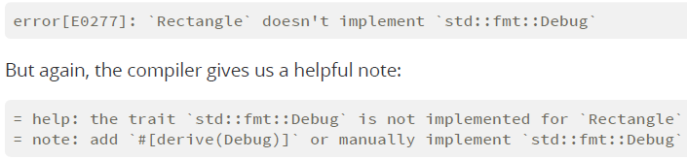
Run the code with this change. Drat! We still get an error:

Slide 212
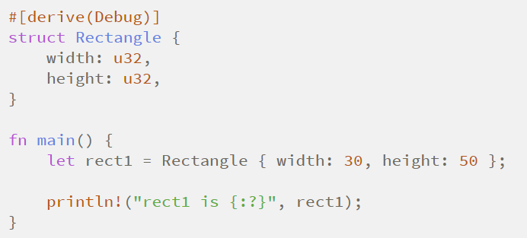
Rust does include functionality to print out debugging information.
But we have to explicitly opt in to make that functionality available for our struct. To do that, we add the annotation #[derive(Debug)] just before the struct definition, as shown in Listing 5-12.

Slide 213
Now when we run the program, we won’t get any errors, and we’ll see the following output:

Slide 214
Method Syntax

Slide 215
Methods are similar to functions
They’re declared with the fn keyword and their name.
They can have parameters and a return value.
They contain some code that is run when they’re called from somewhere else.
However, methods are different from functions in that they’re defined within the context of a struct.
Their first parameter is always self, which represents the instance of the struct the method is being called on.

Slide 216
Defining Methods
Let’s change the area function that has a Rectangle instance as a parameter and instead make an area method defined on the Rectangle struct, as shown in Listing 5-13.

Slide 217
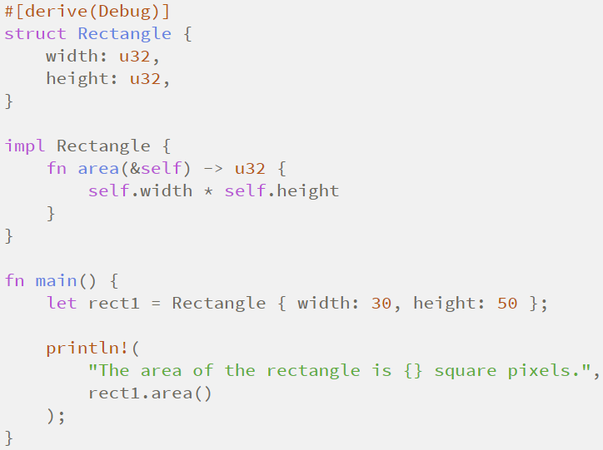
Listing 5-13: Defining an area method on the Rectangle struct

Slide 218
To define the function within the context of Rectangle , we start an impl (implementation) block.
Then we move the area function within the impl curly brackets and change the first (and in this case, only) parameter to be self in the signature and everywhere within the body.

Slide 219
In main, where we called the area function and passed rect1 as an argument, we can instead use method syntax to call the area method on our Rectangle instance. The method syntax goes after an instance: we add a dot followed by the method name, parentheses, and any arguments.

Slide 220
Where’s the -> Operator?
In C and C++, two different operators are used for calling methods: you use . if you’re calling a method on the object directly and -> if you’re calling the method on a pointer to the object and need to dereference the pointer first. In other words, if object is a pointer,
object->something() is similar to (*object).something() .
Rust doesn’t have an equivalent to the -> operator; instead, Rust has a feature called automatic referencing and dereferencing. Calling methods is one of the few places in Rust that has this behavior.

Slide 221
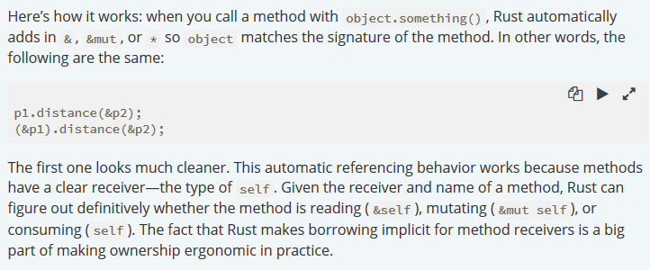
Here’s how it works:

Slide 222
Methods with More Parameters
Let’s practice using methods by implementing a second method on the Rectangle struct.
This time, we want an instance of Rectangle to take another instance of Rectangle and return true if the second Rectangle can fit completely within self; otherwise it should return false .
That is, we want to be able to write the program shown in Listing 5-14, once we’ve defined the can_hold method.

Slide 223
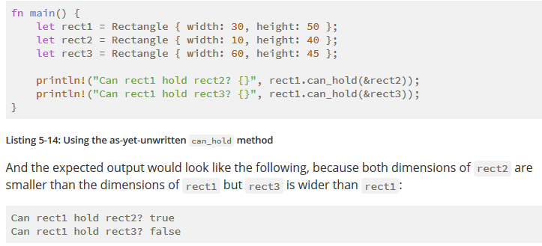
Using the as-yet-unwritten can_hold method

Slide 224
We know we want to define a method, so it will be within the impl Rectangle block. The method name will be can_hold , and it will take an immutable borrow of another Rectangle as a parameter.
The return value of can_hold will be a Boolean, and the implementation will check whether the width and height of self are both greater than the width and height of the other Rectangle, respectively.
Add the new can_hold method to the impl block from Listing 5-13, shown in Listing 5-15.

Slide 225
Implementing the can_hold method on Rectangle
When we run this code with the main function in Listing 5-14, we’ll get our desired output.
Methods can take multiple parameters that we add to the signature after the self parameter, and those parameters work just like parameters in functions.

Slide 226
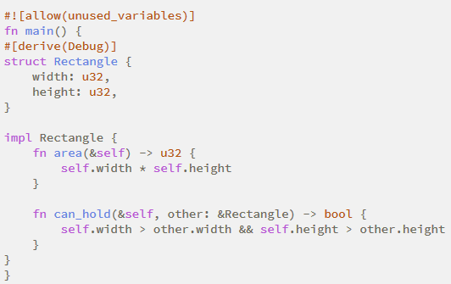
Listing 5-15: Implementing the can_hold method on Rectangle that takes another Rectangle instance as a parameter

Slide 227
Associated Functions
Another useful feature of impl blocks is that we’re allowed to define functions within impl blocks that don’t take self as a parameter.
These are called associated functions because they’re associated with the struct. They’re still functions, not methods, because they don’t have an instance of the struct to work with.
You’ve already used the String::from associated function.

Slide 228
Associated functions are often used for constructors.
Associated functions are often used for constructors that will return a new instance of the struct.
For example, we could provide an associated function that would have one dimension parameter and use that as both width and height, thus making it easier to create a square Rectangle rather than having to specify the same value twice:
To call this associated function, we use the :: syntax with the struct name; et sq = Rectangle::square(3); is an example. This function is namespaced by the struct: the :: syntax is used for both associated functions and namespaces created by modules.

Slide 229
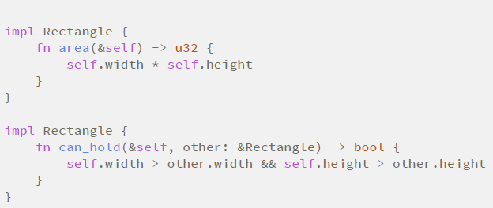
Multiple impl Blocks
Each struct is allowed to have multiple impl blocks.
For example, Listing 5-15 is equivalent to the code shown in Listing 5-16, which has each method in its own impl block.

Slide 230
Outline
Generic Types, Traits, and Lifetimes
10.1. Generic Data Types
10.2. Traits: Defining Shared Behavior
10.3. Validating References with Lifetime
Functional Language Features: Iterators and Closures
13.1. Closures: Anonymous Functions
Fearless Concurrency
16.1. Using Threads to Run Code Simultaneously

Slide 231
Generic Data Types
We can use generics to create definitions for items like function signatures or structs, which we can then use with many different concrete data types.

Slide 232
Ways to provide the generic code
There are two ways to provide the generic code:
Option<T>
Result<T, E>

Slide 233
Option<T>
Rust standard library provides Option where 'T' is the generic data type. It provides the generic over one type.
enum Option<T>
{
Some(T),
None,
}

Slide 234
Continue...
In the last case, enum is the custom type where <T> is the generic data type. We can substitute the 'T' with any data type. Let's look at this:
let x : Option<i32> = Some(10); // 'T' is of type i32.
let x : Option<bool> = Some(true); // 'T' is of type bool.
let x : Option<f64> = Some(10.5); // 'T' is of type f64.
let x : Option<char> = Some('b'); // 'T' is of type char.

Slide 235
Continue...
In the previous case, we observe that 'T' can be of any type, i.e., i32, bool, f64 or char. But, if the type on the left-hand side and the value on the right hand side doesn’t match, then the error occurs. Let's look at this:
let x : Option<i32> = Some(10.8);

Slide 236
Continue...
In the above case, type on the left-hand side is i32, and the value on the right-hand side is of type f64. Therefore, the error occurs "type mismatched".

Slide 237
Result<T,E>
Rust standard library provides another data type Result<T,E> which is generic over two type, i.e., T & E:
enum Result<T,E>
{ OK(T),
Err(E), }
Note: It is not a convention that we have to use 'T' and 'E'. We can use any capital letter.

Slide 238
Generic Functions
Generics can be used in the functions, and we place the generics in the signature of the function, where the data type of the parameters and the return value is specified.

Slide 239
Continue...
When the function contains a single argument of type 'T'.
Syntax:
fn function_name<T>(x:T) // body of the function.
The above syntax has two parts:
<T> : The given function is a generic over one type.
(x : T) : x is of type T.

Slide 240
Example
fn main() {
let a = vec![1,2,3,4,5];
let b = vec![2.3,3.3,4.3,5.3];
let result = add(&a);
let result1 = add(&b);
println!("The value of result is {}",result);
println!("The value of result1 is {}",result1);
}

Slide 241
Example
fn add<T>(list:&[T])->T
{
let mut c =0;
for &item in list.iter()
{
c= c+item;
}
c
}

Slide 242
Struct Definitions
Structs can also use the generic type parameter in one or more fields using <> operator.
Syntax:
struct structure_name<T>
// Body of the structure.
we declare the generic type within the angular brackets just after the structure_name, and then we can use the generic inside the struct definition.

Slide 243
Example
fn main() {
let integer = Value{a:2,b:3};
let float = Value{a:7.8,b:12.3};
println!("Integer values : {},{}",integer.a,integer.b);
println!("Float values :{},{}",float.a,float.b);
}

Slide 244
Example
fn main() {
let integer = Value{a:2,b:3};
let float = Value{a:7.8,b:12.3};
println!("Integer values : {},{}",integer.a,integer.b);
println!("Float values :{},{}",float.a,float.b);
}

Slide 245
Output:
Integer values : 2,3
Float values : 7.8,12.3
In the above example, Value<T> struct is generic over one type and a and b are of the same type. We create two instances integer and float. Integer contains the values of type i32 and float contains the values of type f64.

Slide 246
Let's see another simple example.
struct Value<T> {
a:T,
b:T,
}
fn main() {
let c = Value{a:2,b:3.6};
println!("c values : {},{}",c.a,c.b);
}

Slide 247
Continue...
In the above example, Value<T> struct is generic over one type, and a and b are of the same type. We create an instance of 'c'. The 'c' contains the value of different types, i.e., i32 and f64.
Therefore, the Rust compiler throws the "mismatched error".

Slide 248
Enum Definitions
An enum can also use the generic data types. Rust standard library provides the Option<T> enum which holds the generic data type. The Option<T> is an enum where 'T' is a generic data type.

Slide 249
Option<T>
It consists of two variants, i.e., Some(T) and None.
Where Some(T) holds the value of type T and None does not contain any value.

Slide 250
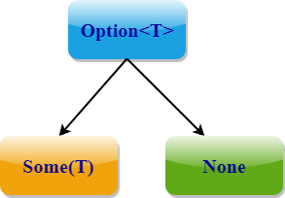

Slide 251
Case
enum Option<T>
{
Some(T),
None,
}
In the above case, Option is an enum which is generic over one type 'T'. It consists of two variants Some(T) and None.

Slide 252
Result<T, E>
We can create the generic of multiple types. This can be achieved through Result<T, E>.
enum Result<T,E>
{
OK(T),
Err(E),
}

Slide 253
Continue...
In the above case, Result<T, E> is an enum which is generic over two types, and it consists of two variants, i.e., OK(T) and Err(E).
OK(T) holds the value of type 'T' while Err(E) holds the value of type 'E'.

Slide 254
Method Definitions
We can implement the methods on structs and enums.
Let's see a simple example:
struct Program<T> {
a: T,
b: T,
}

Slide 255
Example
impl<T> Program<T> {
fn a(&self) -> &T {
&self.a
}
}
fn main() {
let p = Program{ a: 5, b: 10 };
println!("p.a() is {}", p.a());
}

Slide 256
Resolving Ambiguities
Rust compiler automatically infers the generic parameters. Let's understand this through a simple scenario:
Let mut v = Vec::new(); // creating a vector.
v.push(10);.
println!("{:?}", v); // prints the value of v.
In the above case, we insert the integer value into the vector. Therefore, the Rust compiler got to know that the vector v has the type i32.

Slide 257
Continue...
If we delete the second last line, then it looks like;
Let mut v = Vec::new(); // creating a vector.
println!("{:?}", v); // prints the value of v.
The above case will throw an error that "it cannot infer the type for T".

Slide 258
We can solve the above case in two ways:
1. We can use the following annotation:
let v : Vec<bool> = Vec::new();
println!("{:?}",v) ;

Slide 259
Continue...
2. We can bind the generic parameter 'T' by using the 'turbofish' ::<> operator:
let v = Vec :: <bool> :: new();
println!("{:?}",v) ;

Slide 260
Topic 10.2

Slide 261
Traits Defining Shared Behavior

Slide 262
Traits: Defining Shared Behavior
A trait tells the Rust compiler about functionality a particular type has and can share with other types.
We can use traits to define shared behavior in an abstract way.
We can use trait bounds to specify that a generic can be any type that has certain behavior.
Note: Traits are similar to a feature often called interfaces in other languages, although with some differences.

Slide 263
Defining a Trait
A type behavior consists of the methods we can call on that type. Different types share the same behavior if we can call the same methods on all of those types.
Trait definitions are a way to group method signatures together to define a set of behaviors necessary to accomplish some purpose.

Slide 264
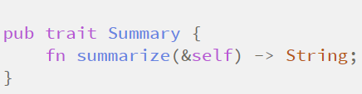
A Summary trait that consists of the behavior provided by a summarize method
We want to make a media aggregator library that can display summaries of data that might be stored in a NewsArticle or Tweet instance.
To do this, we need a summary from each type, and we need to request that summary by calling a summarize method on an instance. Listing 10-12 shows the definition of a Summary trait that expresses this behavior.

Slide 265
Here, we declare a trait using the trait keyword and then the trait’s name, which is Summary in this case. Inside the curly brackets, we declare the method signatures that describe the behaviors of the types that implement this trait, which in this case is fn summarize(&self) -> String.

Slide 266
Implementing a Trait on a Type
Now that we’ve defined the desired behavior using the Summary trait, we can implement it on the types in our media aggregator.
Listing 10-13 shows an implementation of the Summary trait on the NewsArticle struct that uses the headline, the author, and the location to create the return value of summarize .
For the Tweet struct, we define summarize as the username followed by the entire text of the tweet, assuming that tweet content is already limited to 280 characters.

Slide 267
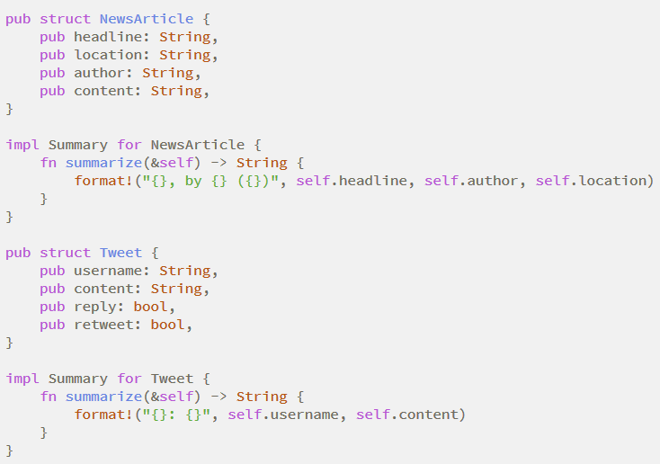
Listing 10-13: Implementing the Summary trait on the NewsArticle and Tweet types

Slide 268
Implementing a trait on a type is similar to implementing regular methods.
The difference is that after impl, we put the trait name that we want to implement, then use the for keyword, and then specify the name of the type we want to implement the trait for.
Within the impl block, we put the method signatures that the trait definition has defined. Instead of adding a semicolon after each signature, we use curly brackets and fill in the method body with the specific behavior that we want the methods of the trait to have for the particular type.

Slide 269
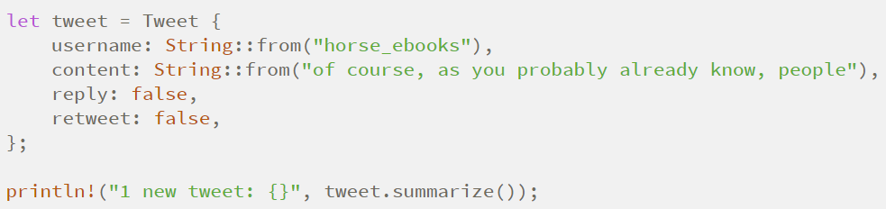
After implementing the trait, we can call the methods on instances of NewsArticle and Tweet in the same way we call regular methods, like this

Slide 270
Let’s say this lib.rs is for a crate we’ve called aggregator and someone else wants to use our crate’s functionality to implement the Summary trait on a struct defined within their library’s scope.
They would need to bring the trait into their scope first. They would do so by specifying use aggregator::Summary; which then would enable them to implement Summary for their type.
One restriction to note with trait implementations is that we can implement a trait on a type only if either the trait or the type is local to our crate. For example, we can implement standard library traits like Display on a custom type like Tweet as part of our aggregator crate functionality, because the type Tweet is local to our aggregator crate.

Slide 271
Default Implementations
Sometimes it’s useful to have default behavior for some or all of the methods in a trait instead of requiring implementations for all methods on every type.

Slide 272
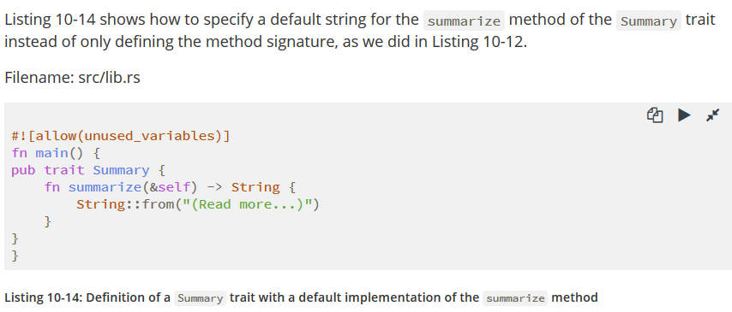
Continue...

Slide 273
To use a default implementation to summarize instances of NewsArticle instead of defining a custom implementation, we specify an empty impl block with impl Summary for NewsArticle {}.

Slide 274
Even though we’re no longer defining the summarize method on NewsArticle directly, we’ve provided a default implementation and specified that NewsArticle implements the Summary trait.
As a result, we can still call the summarize method on an instance of NewsArticle , like this:

Slide 275
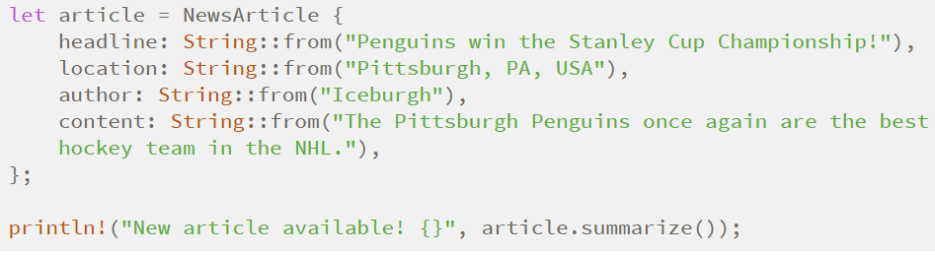
v

Slide 276
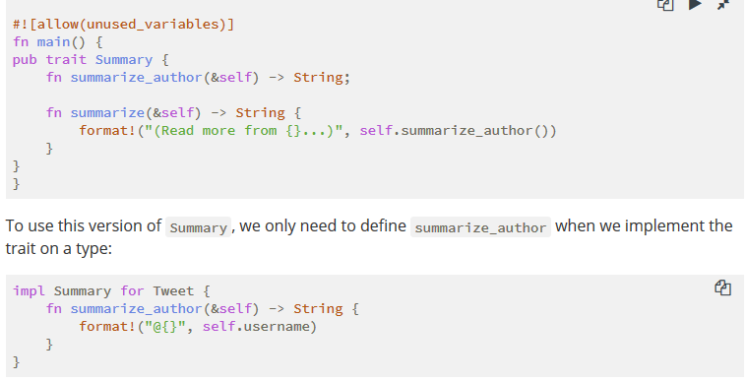
Default implementations can call other methods in the same trait, even if those other methods don’t have a default implementation.

Slide 277
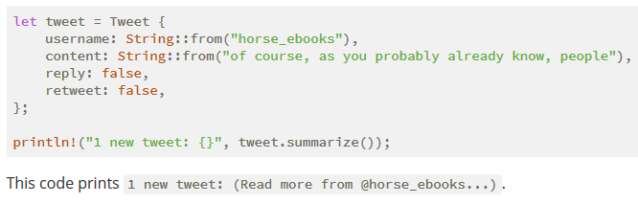
After we define summarize_author , we can call summarize on instances of the Tweet
Note that it isn’t possible to call the default implementation from an overriding implementation of that same method.

Slide 278
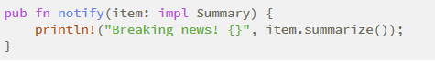
Traits as Parameters
Now that you know how to define and implement traits, we can explore how to use traits to define functions that accept many different types.
Instead of a concrete type for the item parameter, we specify the impl keyword and the trait name.

Slide 279
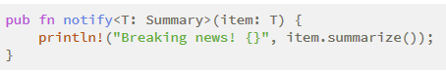
Trait Bound Syntax
The impl Trait syntax works for straightforward cases but is actually syntax sugar for a longer form, which is called a trait bound; it looks like this:

Slide 280
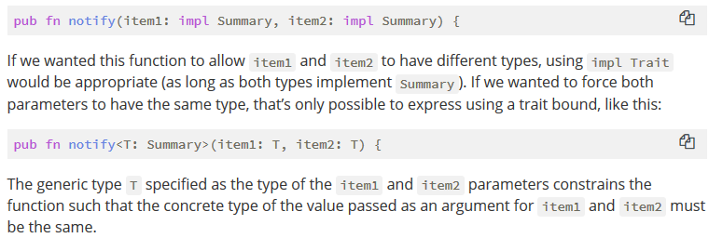
The impl Trait syntax is convenient and makes for more concise code in simple cases.

Slide 281
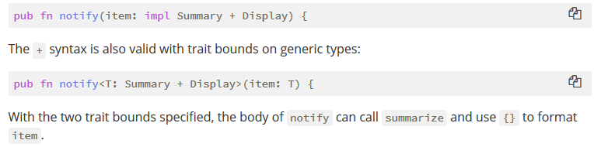
Specifying Multiple Trait Bounds with the + Syntax

Slide 282
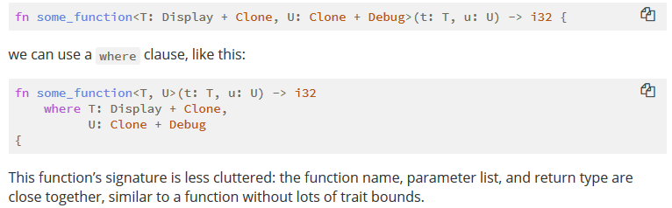
Clearer Trait Bounds with where Clauses

Slide 283
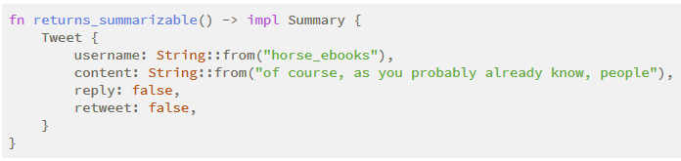
Returning Types that Implement Traits

Slide 284
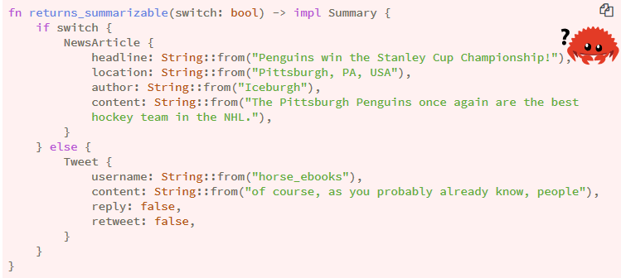
However, you can only use impl Trait if you’re returning a single type. For example, this code that returns either a NewsArticle or a Tweet with the return type specified as impl Summary wouldn’t work:

Slide 285
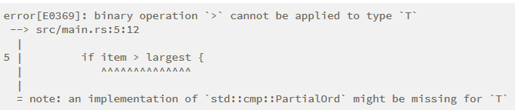
Fixing the largest Function with Trait Bounds

Slide 286
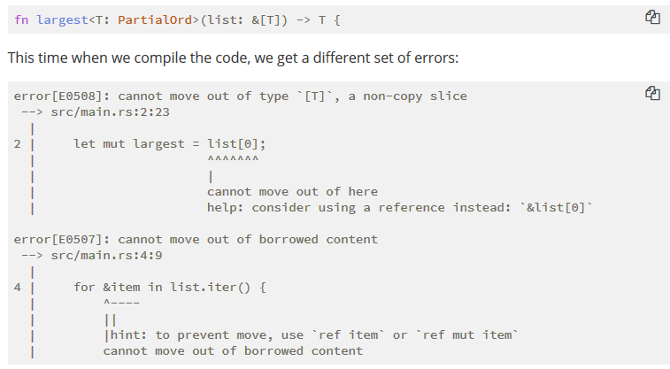
This time when we compile the code, we get a different set of errors:

Slide 287
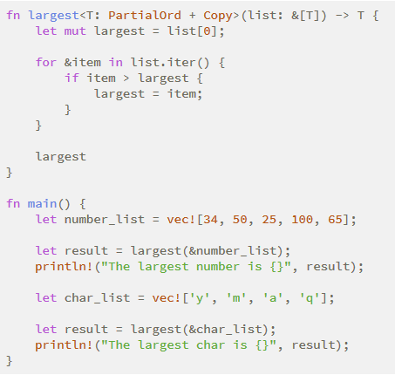
A working definition of the largest function that works on any generic type that implements the PartialOrd and Copy traits
To call this code with only those types that implement the Copy trait, we can add Copy to the trait bounds of T ! Listing 10-15 shows the complete code of a generic largest function that will compile as long as the types of the values in the slice that we pass into the function implement the PartialOrd and Copy traits, like i32 and char do.

Slide 288
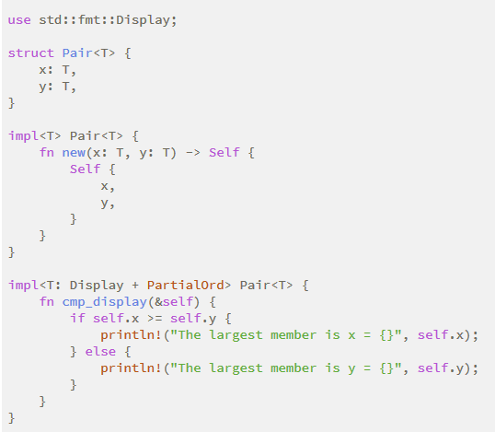
Using Trait Bounds to Conditionally Implement Methods
Conditionally implement methods on a generic type depending on trait bounds

Slide 289

Dungeons and Dragons Example

Slide 290
Yes… We have simplified D&D rules for this presentation
The focus of this talk is traits with D&D used as a metaphor.

Slide 291

D&D Races

Slide 292


Let’s create some structs!
struct Dwarf {
name: String
}
struct Elf {
name: String
}

Slide 293
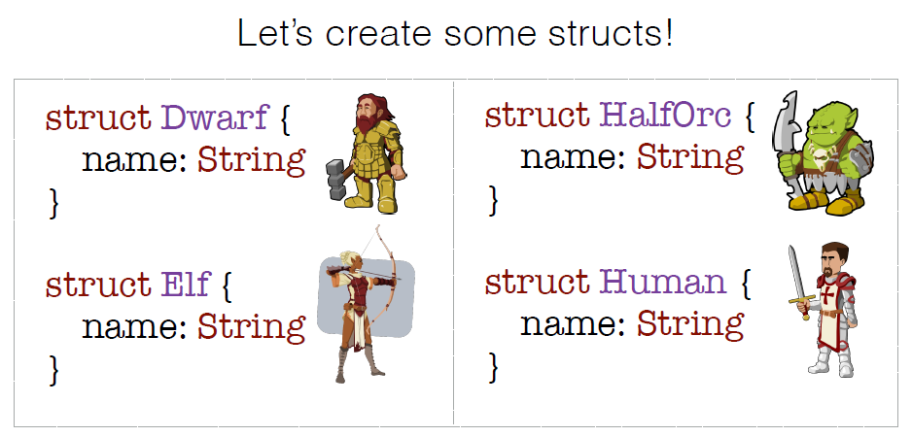
Let’s create some structs!

Slide 294

Let’s make a character!
let my_dwarf = Dwarf {
name: String::from(“NellDwarf”)
};

Slide 295
Character Traits
• Strength
• Dexterity
• Constitution
• Intelligence
• Wisdom
• Charisma

Slide 296
Let’s make a trait!
pub trait Constitution {
}

Slide 297
Let’s make a trait!
pub trait Constitution {
fn constitution_bonus(&self) -> u8;
}

Slide 298

Let’s implement that trait!

Slide 299
Let’s implement that trait!
impl Constitution for Dwarf {
}

Slide 300
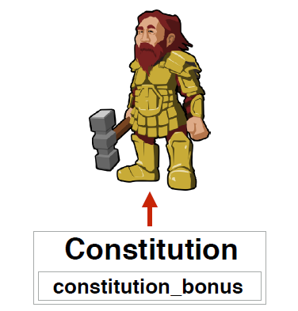
Let’s implement that trait!

Slide 301
Let’s make a trait!
pub trait Constitution {
fn constitution_bonus(&self) -> u8;
}

Slide 302
The constitution bonus for a dwarf is 2

Slide 303
Let’s implement that trait!
impl Constitution for Dwarf {
fn constitution_bonus(&self) -> u8 {
}
}

Slide 304
Let’s implement that trait!
impl Constitution for Dwarf {
fn constitution_bonus(&self) -> u8 {
2
}
}

Slide 305

Let’s make a character!
let my_dwarf = Dwarf {
name: String::from(“NellDwarf”)
};

Slide 306
Let’s make a character!
let my_dwarf = Dwarf {
name: String::from(“NellDwarf”)
};
my_dwarf.constitution_bonus();
// Returns 2

Slide 307
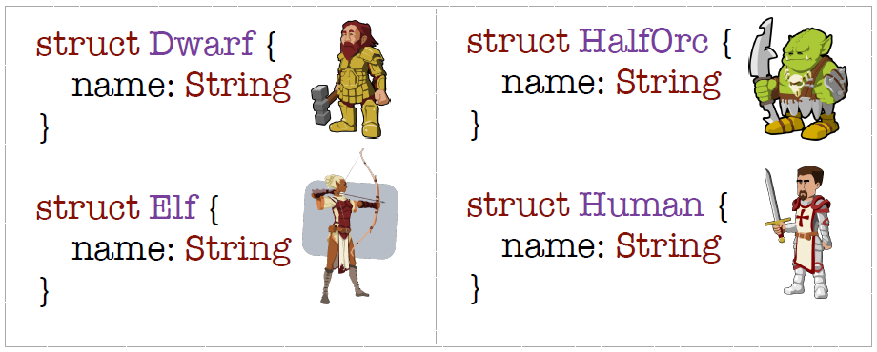
Let’s implement that trait!

Slide 308

Let’s implement that trait!

Slide 309
Let’s implement that trait!
impl Constitution for HalfOrc {
}

Slide 310

Let’s implement that trait!

Slide 311
The constitution bonus for a half-orc is 1

Slide 312

Let’s implement that trait!
impl Constitution for HalfOrc {
fn constitution_bonus(&self) -> u8 {
1
}
}

Slide 313
Let’s implement that trait!
let my_half_orc = HalfOrc {
name: String::from(“NellOrc”)
};

Slide 314
Let’s implement that trait!
let my_half_orc = HalfOrc {
name: String::from(“NellOrc”)
};
my_half_orc.constitution_bonus();
// Returns 1

Slide 315

Let’s implement that trait!

Slide 316
The constitution bonus for both a human and a half-elf is 0

Slide 317
We could implement it like this…
impl Constitution for Elf {
fn constitution_bonus(&self) -> u8 {
0
}
Repetitive!
}
impl Constitution for Human {
fn constitution_bonus(&self) -> u8 {
0
}
}

Slide 318
Most races have a constitution bonus of 0…

Slide 319
Let’s make 0 the default

Slide 320
Let’s add a default!
pub trait Constitution {
fn constitution_bonus(&self) -> u8;
}

Slide 321
Let’s add a default!
pub trait Constitution {
fn constitution_bonus(&self) -> u8 {
0
}
}

Slide 322

Let’s implement that trait!

Slide 323


Let’s implement that trait!
impl Constitution for Elf {
}
impl Constitution for Human {
}

Slide 324

Let’s implement that trait!
let my_elf = Elf {
name: String::from(“NellElf”)
};

Slide 325
Let’s implement that trait!
let my_elf = Elf {
name: String::from(“NellElf”)
};
my_elf.constitution_bonus();
// Returns 0

Slide 326

Let’s implement that trait!
let my_human = Human {
name: String::from(“Nell”)
};

Slide 327
Let’s implement that trait!
let my_human = Human {
name: String::from(“Nell”)
};
my_human.constitution_bonus();
// Returns 0

Slide 328
Yay! We have a trait!

Slide 329
Section Break

Slide 330
Presentation for Rust Quiz # 4
Prepared by: ( RUSTLING KNIGHTS )
Anas Baig (Team Leader)
Arsalan Nawaz
Muhammad Danial Siddiqui
Sheikh Hassaan Bin Nadeem

Slide 331
E N U M S & P A T T E R N M A T C H I N G
C H A P T E R # 6

Slide 332
6.1 Enums

Slide 333
Defining Enums
Enumerations or Enums are a custom data type that allow you to define a type by enumerating its possible values.

Slide 334
Example:
IP Addresses: Version 4 or Version 6
The property of being V4 or V6 at a time make enum structures appropriate, because enum values can only be one of the variants.
But both versions are still IP Addresses and should be treated as the same type.

Slide 335
Code it:
enum IpAddrKind {
V4,
V6,
}
Variants

Slide 336
Creating Instances:
#![allow(unused_variables)]
fn main() {
enum IpAddrKind {
V4,
V6, }
let four = IpAddrKind::V4;
let six = IpAddrKind::V6; }

Slide 337
Defining & Calling a Function:
We can define a function that takes any IpAddrkind and can call it with either of its variant.
#![allow(unused_variables)]
fn main() {
enum IpAddrKind {
V4,
V6,
}
fn route(ip_type: IpAddrKind) { }
}

Slide 338
Where’s the Data?
We’ve just learnt how to make Enums and to create instances and defining and calling functions.
But we have not stored any data in last example.
So we can add data using structs and by some other ways..

Slide 339
Adding Data Using Structs:
enum IpAddrKind {
V4,
V6,
}
struct IpAddr {
kind: IpAddrKind,
address: String,
}
let home = IpAddr {
kind: IpAddrKind::V4,
address: String::from("127.0.0.1"),
};
let loopback = IpAddr {
kind: IpAddrKind::V6,
address: String::from("::1"),
};
Notes:
Here, everything is in the main function already. We’ve defined a struct IpAddr that has two fields: a kind field that is of type IpAddrKind (the enum we defined ) and an address field of type String. We have two instances of this struct. The first, home, has the value IpAddrKind::V4 as its kind with associated address data of 127.0.0.1. The second instance, loopback, has the other variant of IpAddrKind as its kind value, V6, and has address ::1 associated with it.

Slide 340
A Concise Way Using an Enum:
Hurray!
We’ve finally used structs to somehow associate values with the variants.
BUT
We can do the same thing in a more concise way using just an enum.

Slide 341
Adding Data Using Enums:
This new definition of the IpAddr enum says that both V4 and V6 variants will have associated String values.
enum IpAddr {
V4(String),
V6(String),
}
let home = IpAddr::V4(String::from("127.0.0.1"));
let loopback = IpAddr::V6(String::from("::1"));
Notes:
This new definition of the IpAddr enum says that both V4 and V6 variants will have associated String values.

Slide 342
An Advantage Against Struct:
Each variant can have different types and amounts of associated data in enums.
enum IpAddr {
V4(u8, u8, u8, u8),
V6(String),
}
let home = IpAddr::V4(127, 0, 0, 1);
let loopback = IpAddr::V6(String::from("::1"));
Notes:
Version four type IP addresses will always have four numeric components that will have values between 0 and 255. If we wanted to store V4 addresses as four u8 values but still express V6 addresses as one String value, we wouldn’t be able to with a struct. Enums handle this case with ease.

Slide 343
Standard Library Definition for IpAddr:
struct Ipv4Addr {
// --snip--
}
struct Ipv6Addr {
// --snip--
}
enum IpAddr {
V4(Ipv4Addr),
V6(Ipv6Addr),
}
As we wanted to store IP addresses and encode which kind they are is so common that the standard library has a definition we can use! Let’s look at how the standard library defines IpAddr.
Notes:
It has the exact enum and variants that we’ve defined and used, but it embeds the address data inside the variants in the form of two different structs, which are defined differently for each variant.

Slide 344
Is This A Win For Any Data Type!
Yes! The previous codes shown us that we can put any kind of data inside an Enum Variant.
We can even include Enums!
Notes:
Note that even though the standard library contains a definition for IpAddr, we can still create and use our own definition without conflict because we haven’t brought the standard library’s definition into our scope. We’ll talk more about bringing types into scope in the next chapter.

Slide 345
Another Example:
A message enum which has a wide variety of types embedded in its variants.
enum Message {
Quit,
Move { x: i32, y: i32 },
Write(String),
ChangeColor(i32, i32, i32),
}
Notes:
This enum has four variants with different types:
Quit has no data associated with it at all.
Move includes an anonymous struct inside it.
Write includes a single String.
ChangeColor includes three i32 values

Slide 346
Same Thing Using Structs:
Defining an enum with variants is almost similar to defining different kinds of struct definitions.
struct QuitMessage; // unit struct
struct MoveMessage {
x: i32,
y: i32,
}
struct WriteMessage(String); // tuple struct
struct ChangeColorMessage(i32, i32, i32); // tuple struct

Slide 347
So Enums are Easy!
Because if we use different structs which have different types than we couldn’t as easily define a function to take any of these kinds of messages as we could with the Message enum which itself is only single type.

Slide 348
One More Similarity: “Impl Block”
Just as we’re able to define methods on structs using impl, we’re also able to define methods on enums.
impl Message {
fn call(&self) {
// method body would be defined here
}
}
let m = Message::Write(String::from("hello"));
m.call();
Notes:
The body of the method would use self to get the value that we called the method on. In this example, we’ve created a variable m that has the value Message::Write(String::from("hello")), and that is what self will be in the body of the call method when m.call() runs.

Slide 349
6.2 The “Option” Enum

Slide 350
The “Option” Enum:
The “Option” enum is another enum defined by the standard library. The Option type is used in many places because it encodes the very common scenario in which a value could be something or it could be nothing.

Slide 351
Null Feature for Languages:
Null is a value that means there is no value there. In languages with null, variables can always be in one of two states: null or not-null.
Problem?
The problem with null values is that if you try to use a null value as a not-null value, you’ll get an error of some kind. Because this null or not-null property is pervasive, it’s extremely easy to make this kind of error.
Notes:
In his 2009 presentation “Null References: The Billion Dollar Mistake,” Tony Hoare, the inventor of null, has this to say:
I call it my billion-dollar mistake. At that time, I was designing the first comprehensive type system for references in an object-oriented language. My goal was to ensure that all use of references should be absolutely safe, with checking performed automatically by the compiler. But I couldn’t resist the temptation to put in a null reference, simply because it was so easy to implement. This has led to innumerable errors, vulnerabilities, and system crashes, which have probably caused a billion dollars of pain and damage in the last forty years.
The problem isn’t really with the concept but with the particular implementation.

Slide 352
Does Rust have Nulls?
No! However, the concept that null is trying to express is still a useful one: a null is a value that is currently invalid or absent for some reason.
So, What does Rust have?
Enum! that can encode the concept of a value being present or absent. This enum is “Option<T>”, and it is defined in the standard library.

Slide 353
The “Option<T>” Enum Defined by Std. Lib:
The Option<T> enum is so useful that it’s even included in the prelude; you don’t need to bring it into scope explicitly. In addition, so are its variants: you can use Some and None directly without the Option:: prefix. The Option<T> enum is still just a regular enum, and Some(T) and None are still variants of type Option<T>.
enum Option<T> {
Some(T),
None,
}
}
Notes:
<T> means the Some variant of the Option enum can hold one piece of data of any type.

Slide 354
Example:
Here we’ve an example of using Option values to hold number types and string types.If we use None rather than Some, we need to tell Rust what type of Option<T> we have, because the compiler can’t infer the type that the Some variant will hold by looking only at a None value.
let some_number = Some(5);
let some_string = Some("a string");
let absent_number: Option<i32> = None;
Notes:
When we have a Some value, we know that a value is present and the value is held within the Some. When we have a None value, in some sense, it means the same thing as null:we don’t have a valid value.

Slide 355
So Why Option<T> is Better than having Null?
Because Option<T> and T (where T can be any type) are different types, the compiler won’t let us use an Option<T> value as if it were definitely a valid value. Like a code which is trying to add an i8 to an Option<i8> won’t compile and will give an error because Rust doesn’t understand how to add an i8 and an Option<i8>, because they’re different types.
let x: i8 = 5;
let y: Option<i8> = Some(5);
let sum = x + y;
Notes:
When we have a value of a type like i8 in Rust, the compiler will ensure that we always have a valid value. We can proceed confidently without having to check for null before using that value. Only when we have an Option<i8> (or whatever type of value we’re working with) do we have to worry about possibly not having a value, and the compiler will make sure we handle that case before using the value.In other words, you have to convert an Option<T> to a T before you can perform T operations with it. Generally, this helps catch one of the most common issues with null: assuming that something isn’t null when it actually is.

Slide 356
That’s How You Code Safely and Confidently!
In order to have a value that can possibly be null, you must explicitly opt in by making the type of that value Option<T>. Everywhere that a value has a type that isn’t an Option<T>, you can safely assume that the value isn’t null. That’s how Rust increases the safety of code.
Notes:
Not having to worry about incorrectly assuming a not-null value helps you to be more confident in your code. In order to have a value that can possibly be null, you must explicitly opt in by making the type of that value Option<T>. Then, when you use that value, you are required to explicitly handle the case when the value is null.

Slide 357
6.3 “Match”
Control Flow Operator

Slide 358
The “Match” Control Flow Operator:
“Match” is an extremely powerful control flow operator which allows you to compare a value against a series of patterns and then execute code based on which pattern matches.
Patterns can be made up of literal values, variable names, wildcards, and many other things.

Slide 359

Let’s Talk About Coin-Sorting Machine!
Coins slide down a track with variously sized holes along it, and each coin falls through the first hole it encounters that it fits into.
Cardboard Coin-Sorting Machine

Slide 360
Code It:
enum Coin {
Penny,
Nickel,
Dime,
Quarter,
}
fn value_in_cents(coin: Coin) -> u8 {
match coin {
Coin::Penny => 1,
Coin::Nickel => 5,
Coin::Dime => 10,
Coin::Quarter => 25,
}
}
In the same way as the coin sorting machine works, values go through each pattern in a match, and at the first pattern the value “fits,” the value falls into the associated code block to be used during execution.
Notes:
Here we’ve a function that can take an unknown United States coin and, in a similar way as the counting machine, determine which coin it is and return its value in cents.

Slide 361
Let’s Break Down “Match”
fn value_in_cents(coin: Coin) -> u8 {
match coin {
Coin::Penny => {
println!("Lucky penny!");
1
},
Coin::Nickel => 5,
Coin::Dime => 10,
Coin::Quarter => 25,
}
}
Notes:
First, we list the match keyword followed by an expression, which in this case is the value coin. The type of coin in this example is the Coin enum that we defined in function parameter.Next are the match arms. An arm has two parts: a pattern and some code. The first arm here has a pattern that is the value Coin::Penny and then the => operator that separates the pattern and the code to run. The code in this case is just the value 1. Each arm is separated from the next with a comma.When the match expression executes, it compares the resulting value against the pattern of each arm, in order. If a pattern matches the value, the code associated with that pattern is executed. If that pattern doesn’t match the value, execution continues to the next arm, much as in a coin-sorting machine. We can have as many arms as we need, our match has four arms.
The code associated with each arm is an expression, and the resulting value of the expression in the matching arm is the value that gets returned for the entire match expression.

Slide 362
Why didn’t we use “ If ” ?
Because the expression with “ If ” needs to return a boolean value but with “Match”, it can be any type...

Slide 363
Curly Brackets in Match Arm:
Curly brackets typically aren’t used if the match arm code is short, as it was in the last example where each arm just returns a value. If you want to run multiple lines of code in a match arm, you can use curly brackets.
fn value_in_cents(coin: Coin) -> u8 {
match coin {
Coin::Penny => 1,
Coin::Nickel => 5,
Coin::Dime => 10,
Coin::Quarter(state) => {
println!("State quarter from {:?}!", state);
25
},
}
}

Slide 364
Patterns That Bind to Values:
Another useful feature of match arms is that they can bind to the parts of the values that match the pattern. This is how we can extract values out of enum variants.

Slide 365
Example:
From last example, let’s change one of our enum variants to hold data inside it. From 1999 through 2008, the United States minted quarters with different designs for each of the 50 states on one side. No other coins got state designs, so only quarters have this extra value. We can add this information to our enum by changing the Quarter variant to include a UsState value stored inside it.
enum UsState {
Alabama,
Alaska,
// --snip--
}
enum Coin {
Penny,
Nickel,
Dime,
Quarter(UsState),
}

Slide 366
Continued..
Let’s imagine that a friend of ours is trying to collect all 50 state quarters. While we sort our loose change by coin type, we’ll also call out the name of the state associated with each quarter so if it’s one our friend doesn’t have, they can add it to their collection.
fn value_in_cents(coin: Coin) -> u8 {
match coin {
Coin::Penny => 1,
Coin::Nickel => 5,
Coin::Dime => 10,
Coin::Quarter(state) => {
println!("State quarter from {:?}!", state);
25
},
}
}
Notes:
n the match expression for this code, we add a variable called state to the pattern that matches values of the variant Coin::Quarter. When a Coin::Quarter matches, the state variable will bind to the value of that quarter’s state. Then we can use state in the code for that arm.

Slide 367
What if we Call a Particular State!
If we were to call value_in_cents(Coin::Quarter(UsState::Alaska)),
coin would be Coin::Quarter(UsState::Alaska).
When we compare that value with each of the match arms, none of them match until we reach Coin::Quarter(state). At that point, the binding for state will be the value UsState::Alaska. We can then use that binding in the println! expression, thus getting the inner state value out of the Coin enum variant for Quarter.

Slide 368
6.4 Matching With Option<T>

Slide 369
Matching With Option<T>:
When we talked about the Option<T>, we wanted to get the inner T value out of the “Some” case when using Option<T>; we can also handle Option<T> using match as we did with the Coin enum! Instead of comparing coins, we’ll compare the variants of Option<T>, but the way that the match expression works remains the same.

Slide 370
Example:
Let’s write a function that takes an Option<i32> and, if there’s a value inside, adds 1 to that value. If there isn’t a value inside, the function should return the None value and not attempt to perform any operations.
fn plus_one(x: Option<i32>) -> Option<i32> {
match x {
None => None,
Some(i) => Some(i + 1),
}
}
let five = Some(5);
let six = plus_one(five);
let none = plus_one(None);
Notes:
Let’s examine the first execution of plus_one in more detail. When we call plus_one(five), the variable x in the body of plus_one will have the value Some(5). We then compare that against each match arm.
None => None,
The Some(5) value doesn’t match the pattern None, so we continue to the next arm.
Some(i) => Some(i + 1),
Does Some(5) match Some(i)? Why yes it does! We have the same variant. The i binds to the value contained in Some, so i takes the value 5. The code in the match arm is then executed, so we add 1 to the value of i and create a new Some value with our total 6 inside.
Now let’s consider the second call of plus_one in Listing 6-5, where x is None. We enter the match and compare to the first arm.
None => None,
It matches! There’s no value to add to, so the program stops and returns the None value on the right side of =>. Because the first arm matched, no other arms are compared.

Slide 371
Matches are Exhaustive!
Consider this version of our plus_one function that has a bug and won’t compile because we didn’t handle the None case.
fn plus_one(x: Option<i32>) -> Option<i32> {
match x {
Some(i) => Some(i + 1),
}
}
Notes:
Rust knows that we didn’t cover every possible case and even knows which pattern we forgot! Matches in Rust are exhaustive: we must exhaust every last possibility in order for the code to be valid. Especially in the case of Option<T>, when Rust prevents us from forgetting to explicitly handle the None case, it protects us from assuming that we have a value when we might have null, thus making the billion-dollar mistake discussed earlier.

Slide 372
The Placeholder Pattern:
Rust also has a pattern we can use when we don’t want to list all possible values. For example, a u8 can have valid values of 0 through 255. If we only care about the values 1, 3, 5, and 7, we don’t want to have to list out 0, 2, 4, 6, 8, 9 all the way up to 255. Fortunately, we don’t have to: we can use the special pattern _ instead:
let some_u8_value = 0u8;
match some_u8_value {
1 => println!("one"),
3 => println!("three"),
5 => println!("five"),
7 => println!("seven"),
_ => (),
}
Notes:
The _ pattern will match any value. By putting it after our other arms, the _ will match all the possible cases that aren’t specified before it. The () is just the unit value, so nothing will happen in the _ case. As a result, we can say that we want to do nothing for all the possible values that we don’t list before the _ placeholder.

Slide 373
C H A P T E R # 7
P A C K A G E S , C R A T E S & M O D U L E S

Slide 374
INTRODUCTION :
What names does the compiler know about at this location in the code?
What functions am I allowed to call? What does this variable refer to?
The Module System encompasses
Packages are a Cargo feature that let you build, test, and share crates.
Crates are a tree of modules that produce a library or executable.
Modules and the use keyword let you control the scope and privacy of paths.
A path is a way of naming an item such as a struct, function, or modules
Notes:
Rust has a number of features related to scopes. This is sometimes called “the module system,” but it encompasses more than just modules:

Slide 375
PACKAGES AND CRATES FOR MAKING LIBRARIES AND EXECUTABLES :
A crate is a binary or library.
The crate root is a source file that is used to know how to build a crate.
A package has a Cargo.toml that describes how to build one or more crates. At most one crate in a package can be a library.

Slide 376
(CONTINUED):
Example of a Package:
$ cargo new my-project
Created binary (application) `my-project` package
$ ls my-project
Cargo.toml
src
$ ls my-project/src
main.rs
Notes:
Because Cargo created a Cargo.toml, that means we now have a package. If we look at the contents of Cargo.toml, there’s no mention of src/main.rs. However, Cargo’s conventions are that if you have a src directory containing main.rs in the same directory as a package’s Cargo.toml, Cargo knows this package contains a binary crate with the same name as the package, and src/main.rs is its crate root. Another convention of Cargo’s is that if the package directory contains src/lib.rs, the package contains a library crate with the same name as the package, and src/lib.rs is its crate root. The crate root files are passed by Cargo to rustc to actually build the library or binary.
A package can contain zero or one library crates and as many binary crates as you’d like. There must be at least one crate (either a library or a binary) in a package.
If a package contains both src/main.rs and src/lib.rs, then it has two crates: a library and a binary, both with the same name. If we only had one of the two, the package would have either a single library or binary crate. A package can have multiple binary crates by placing files in the src/bin directory: each file will be a separate binary crate.

Slide 377
THE MODULE SYSTEM TO CONTROL SCOPE AND PRIVACY :
Features:
Modules, a way to organize code and control the privacy of paths
Paths, a way to name items
use, a keyword to bring a path into scope
pub, a keyword to make items public
Renaming items when bringing them into scope with the as keyword

Slide 378
THE MODULE SYSTEM TO CONTROL SCOPE AND PRIVACY :
Features (continued):
6. Using external packages
7. Nested paths to clean up large use lists
8. Using the glob operator to bring everything in a module into scope
9. How to split modules into individual files

Slide 379
MODULES :
Modules let us organize code into groups.
Example:
mod sound {
fn guitar() {
// Function body code goes here
}
}
fn main() {
}
Notes:
We can structure our code by organizing our code in multiple modules. We’ve defined two functions, guitar and main. We’ve defined the guitar function within a mod block. This block defines a module named sound.

Slide 380
MODULES (NESTED) :
mod sound {
mod instrument {
mod woodwind {
fn clarinet() {
// Function body code goes here
}
}
}
mod voice {
}
}
fn main() {
}
Notes:
In this example, we defined a sound module. We then defined two modules within the sound module named instrument and voice. The instrument module has another module defined within it, woodwind, and that module contains a function named clarinet.

Slide 381
MODULES (NESTED) :
Hierarchy
crate
└── sound
├── instrument
│ └── woodwind
└── voice
Notes:
This tree shows how some of the modules nest inside one another (such as woodwind nests inside instrument) and how some modules are siblings to each other (instrument and voice are both defined within sound). The entire module tree is rooted under the implicit module named crate.

Slide 382
MODULE TREE VS FILESYSTEM :
This tree might remind you of the directory tree of the filesystem you have on your computer
Just like directories in a filesystem, you place code inside whichever module will create the organization you’d like.
Another similarity is that to refer to an item in a filesystem or a module tree, you use its path

Slide 383
PATHS :
If we want to call a function, we need to know its path
A path can take two forms:
An absolute path starts from a crate root by using a crate name or a literal “crate”.
A relative path starts from the current module and uses “self”, “super”, or an identifier in the current module.
Both absolute and relative paths are followed by one or more identifiers separated by double colons ( :: ) .

Slide 384
PATHS (EXAMPLE) :
mod sound {
mod instrument {
fn clarinet() {
// Function body code goes here
}
}
}
fn main() {
// Absolute path
crate::sound::instrument::clarinet();
// Relative path
sound::instrument::clarinet();
}
Notes:
The first way we’re calling the clarinet function from the main function uses an absolute path. Because clarinet is defined within the same crate as main, we use the crate keyword to start an absolute path. Then we include each of the modules until we make our way to clarinet. This is similar to specifying the path /sound/instrument/clarinet to run the program at that location on your computer; using the crate name to start from the crate root is like using / to start from the filesystem root in your shell.
The second way we’re calling the clarinet function from the main function uses a relative path. The path starts with the name sound, a module defined at the same level of the module tree as the main function. This is similar to specifying the path sound/instrument/clarinet to run the program at that location on your computer; starting with a name means that the path is relative.
This code won’t compile yet
The error messages say that module instrument is private. We can see that we have the correct paths for the instrument module and the clarinet function, but Rust won’t let us use them because they’re private. It’s time to learn about the pub keyword.

Slide 385
MODULES AS PRIVACY BOUNDARY :
Modules are used for organization
Modules are also used for privacy boundary in Rust.
Privacy rules:
All items (functions, methods, structs, enums, modules, and constants) are private by default.
You can use the pub keyword to make an item public.
You aren’t allowed to use private code defined in modules that are children of the current module.
You are allowed to use any code defined in ancestor modules or the current module.
.
Notes:
If you want to make an item like a function or struct private, you put it in a module
In other words, items without the pub keyword are private as you look “down” the module tree from the current module, but items without the pub keyword are public as you look “up” the tree from the current module. Again, think of a filesystem: if you don’t have permissions to a directory, you can’t look into it from its parent directory. If you do have permissions to a directory, you can look inside it and any of its ancestor directories.

Slide 386
PATHS (EXAMPLE WITH PUB) :
mod sound {
pub mod instrument {
pub fn clarinet() {
// Function body code goes here
}
}
}
fn main() {
// Absolute path
crate::sound::instrument::clarinet();
// Relative path
sound::instrument::clarinet();
}
Notes:
The privacy rules apply to structs, enums, functions, and methods as well as modules.
So we will add the pub keyword to both module and the function within
In the absolute path case, we start with crate, the root of our crate. From there, we have sound, and it is a module that is defined in the crate root. The sound module isn’t public, but because the main function is defined in the same module that sound is defined, we’re allowed to refer to sound from main. Next is instrument, which is a module marked with pub. We can access the parent module of instrument, so we’re allowed to access instrument. Finally, clarinet is a function marked with pub and we can access its parent module, so this function call works!
In the relative path case, the logic is the same as the absolute path except for the first step. Rather than starting from the crate root, the path starts from sound. The sound module is defined within the same module as main is, so the relative path starting from the module in which main is defined works. Then because instrument and clarinet are marked with pub, the rest of the path works and this function call is valid as well!

Slide 387
STARTING RELATIVE PATHS WITH SUPER :
fn main() {}
mod instrument {
fn clarinet() {
super::breathe_in();
}
}
fn breathe_in() {
// Function body code goes here
}
Notes:
We can also construct relative paths beginning with super. Doing so is like starting a filesystem path with ..: the path starts from the parent module, rather than the current module.
Super eliminates the need of respecifying the path if a module is moved inside another module. E.g. if instrument module is moved inside sound module in this case.

Slide 388
USING PUB WITH STRUCTS :
mod plant {
pub struct Vegetable {
pub name: String,
id: i32,
}
impl Vegetable {
pub fn new(name: &str) -> Vegetable {
Vegetable {
name: String::from(name),
id: 1,
}
}
}
}
fn main() {
let mut v = plant::Vegetable::new("squash");
v.name = String::from("butternut squash");
println!("{} are delicious", v.name);
// println!("The ID is {}", v.id);
}
Notes:
You can designate structs and enums to be public in a similar way as we’ve shown with modules and functions, with a few additional details.
If you use pub before a struct definition, you make the struct public. However, the struct’s fields are still private. You can choose to make each field public or not on a case-by-case basis.
Because the name field of the plant::Vegetable struct is public, in main we can write and read to the name field by using dot notation. We’re not allowed to use the id field in main because it’s private.

Slide 389
USING PUB WITH ENUMS :
mod menu {
pub enum Appetizer {
Soup,
Salad,
}
}
fn main() {
let order1 = menu::Appetizer::Soup;
let order2 = menu::Appetizer::Salad;
}
Notes:
if you make a public enum, all of its variants are public. You only need the pub before the enum keyword.
Because we made the Appetizer enum public, we’re able to use the Soup and Salad variants in main.

Slide 390
THE “USE” KEYWORD TO BRING ABSOLUTE PATHS INTO A SCOPE :
mod sound {
pub mod instrument {
pub fn clarinet() {
// Function body code goes here
}
}
}
use crate::sound::instrument;
fn main() {
instrument::clarinet();
instrument::clarinet();
instrument::clarinet();
}
Notes:
many of the paths we’ve written to call functions in the listings in this chapter are long and repetitive.
there’s a way to bring a path into a scope once and then call the items in that path as if they’re local items: with the use keyword.
we bring the crate::sound::instrument module into the scope of the main function so that we only have to specify instrument::clarinet to call the clarinet function in main.
Adding use and a path in a scope is similar to creating a symbolic link in the filesystem.
Paths brought into scope with use also check privacy, like any other paths.

Slide 391
THE “USE” KEYWORD TO BRING RELATIVE PATHS INTO A SCOPE :
mod sound {
pub mod instrument {
pub fn clarinet() {
// Function body code goes here
}
}
}
use self::sound::instrument;
fn main() {
instrument::clarinet();
instrument::clarinet();
instrument::clarinet();
}
Notes:
If you want to bring an item into scope with use and a relative path, there’s a small difference from directly calling the item using a relative path: instead of starting from a name in the current scope, you must start the path given to use with self.

Slide 392
ABSOLUTE VS RELATIVE PATHS WITH “USE” :
mod sound {
pub mod instrument {
pub fn clarinet() {
// Function body code goes here
}}}
mod performance_group {
use crate::sound::instrument;
pub fn clarinet_trio() {
instrument::clarinet();
instrument::clarinet();
instrument::clarinet();
}}
fn main() {
performance_group::clarinet_trio();
}
Notes:
Choosing to specify absolute paths with use can make updates easier if the code calling the items moves to a different place in the module tree but the code defining the items does not.
For relative path, we would need to change use self::sound::instrument to use super::sound::instrument.

Slide 393
Idiomatic use Paths for Functions
mod sound {
pub mod instrument {
pub fn clarinet() {
// Function body code goes here
}
}
}
use crate::sound::instrument::clarinet;
fn main() {
clarinet();
clarinet();
clarinet();
}
Notes:
We could have used the “use” keyword as mentioned here and called the clarinet() function directly.
But for functions, it’s considered idiomatic to specify the function’s parent module with use, and then specify the parent module when calling the function.
Doing so rather than specifying the path to the function with use makes it clear that the function isn’t locally defined, while still minimizing repetition of the full path.

Slide 394
Idiomatic use Paths for Structs/Enums & Other Items
use std::collections::HashMap;
fn main() {
let mut map = HashMap::new();
map.insert(1, 2);
}
Notes:
For structs, enums, and other items, specifying the full path to the item with use is idiomatic.
There is no strong reason to this idiom. It has become a convention to do this way.

Slide 395
Idiomatic use Paths for Structs/Enums & Other Items
Exception to this idiom is if the use statements would bring two items with the same name into scope, which isn’t allowed.
use std::fmt;
use std::io;
fn function1() -> fmt::Result {}
fn function2() -> io::Result<()> {}
We would have two Result types in the same scope and Rust wouldn’t know which one we meant when we used Result.

Slide 396
Renaming Types Brought Into Scope with the as Keyword
We can bring two types of the same name into the same scope
We can specify a new local name for the type by adding “as” and a new name after the “use”
Example:
use std::fmt::Result;
use std::io::Result as IoResult;
fn function1() -> Result { }
fn function2() -> IoResult<()> { }
Notes:
In the second use statement, we chose the new name IoResult for the std::io::Result type, which won’t conflict with the Result from std::fmt that we’ve also brought into scope. This is also considered idiomatic

Slide 397
Re-exporting Names with pub use
When you bring a name into scope with the use keyword, the name being available in the new scope is private.
If you want to enable code calling your code to be able to refer to the type as if it was defined in that scope just as your code does, you can combine pub and use.
This technique is called re-exporting because you’re bringing an item into scope but also making that item available for others to bring into their scope.

Slide 398
Re-exporting Names with pub use (Example)
mod sound {
pub mod instrument {
pub fn clarinet() {
// Function body code goes here
} } }
mod performance_group {
pub use crate::sound::instrument;
pub fn clarinet_trio() {
instrument::clarinet();
instrument::clarinet();
instrument::clarinet();
} }
fn main() { performance_group::clarinet_trio();
performance_group::instrument::clarinet(); }
Notes:
By using pub use, the main function can now call the clarinet function through this new path with performance_group::instrument::clarinet.
If we hadn’t specified pub use, the clarinet_trio function can call instrument::clarinet in its scope but main wouldn’t be allowed to take advantage of this new path.

Slide 399
Using External Packages
There are many packages that members of the community have published on https://crates.io.
Pulling any of them into your package involves following steps:
listing them in your package’s Cargo.toml
bringing items defined in them into a scope in your package with use.
Example: A package “rand” can be pulled with following code in Cargo.toml file:
[dependencies]
rand = "0.5.5"

Slide 400
Nested Paths for Cleaning Up Large use Lists
When you use many items defined by the same package or in the same module, listing each item on its own line can take up a lot of vertical space in your files.
For example, these two use statements bring items from std into scope:
use std::cmp::Ordering;
use std::io;
We can use nested paths to bring the same items into scope in one line instead of two as:
use std::{cmp::Ordering, io};
Notes:
In programs bringing many items into scope from the same package or module, using nested paths can reduce the number of separate use statements needed by a lot!
We can use nested paths to bring the same items into scope in one line instead of two, by specifying the common part of the path, then two colons, then curly brackets around a list of the parts of the paths that diffe

Slide 401
Bringing All Public Definitions into Scope with the Glob Operator
To bring all public items defined in a path into scope, you can specify that path followed by *, the glob operator
use std::collections::*;
The glob operator is often used when testing to bring everything under test into the tests module
The glob operator is also sometimes used as part of the prelude pattern
Notes:
This use statements brings all public items defined in std::collections into the current scope.
Be careful with using the glob operator! It makes it harder to tell what names are in scope and where a name your program uses was defined.

Slide 402
Separating Modules into Different Files
So far we have defined multiple modules in one file.
When modules get large, you may want to move their definitions to a separate file to make the code easier to navigate.
mod sound;
fn main() {
// Absolute path
crate::sound::instrument::clarinet();
// Relative path
sound::instrument::clarinet();
}
Notes:
In this example, notice the semicolon after mod sound. Which means that in src/main.rs file, we are including the functionality of sound module. The sound module it self is defined in src/sound.rs file separately.

Slide 403
Separating Modules into Different Files (continued)
src/sound.rs file:
pub mod instrument {
pub fn clarinet() {
// Function body code goes here
}
}
The module tree remains the same and the function calls in main continue to work without any modification, even though the definitions live in different files. This lets you move modules to new files as they grow in size.

Slide 404
C H A P T E R # 8
C O M M O N
C O L L E C T I O N

Slide 405
Common Collections
Rust’s standard library includes a number of very useful data structures called collections. Most other * data types represent one specific value, but collections can contain multiple values. We’ll discuss three collections that are used very often in Rust programs:
A Vector 2. A String 3. A Hash Map
1. Vector:
Allows you to store a variable number of values next to each other.
2. String:
Is a collection of characters.
3. Hash Map:
Allows you to associate a value with a particular key. It’s a particular
implementation of the more general data structure called a map.
Notes:
* Unlike the built-in array and tuple types, the data these collections point to is stored on the heap, which means the amount of data does not need to be known at compile time and can grow or shrink as the program runs. Each kind of collection has different capabilities and costs, and choosing an appropriate one for your current situation is a skill you’ll develop over time.
To learn more about the kinds of collections provided by the standard library, click on the below link
https://doc.rust-lang.org/1.30.0/std/collections/index.html

Slide 406
STORING LISTS OF VALUES WITH VECTORS
Vector
The first collection type we’ll look at is Vec<T>, also known as a vector.
Vectors allow you to store more than one value in a single data structure that puts all the values next to each other in memory.
Vectors can only store values of the same type. They are useful when you have a list of items.
Notes:
such as the lines of text in a file or the prices of items in a shopping cart.

Slide 407
Creating The Empty Vector:
Vector
fn main() {
let v: Vec<i32> = Vec::new():
}
Creating The Vector Containing Values:
fn main() {
let v = vec![1,2,3];
println!("The First Value is = {},
Second Value is = {},Third Value is
= {} ",v[0], v[1], v[2]);
}
Notes:
Creating The Empty Vector:
That we added a type annotation here. Because we aren’t inserting any values into this vector, Rust doesn’t know what kind of elements we intend to store. This is an important point. Vectors are implemented using generics; we’ll cover how to use generics with your own types in Chapter 10. For now, know that the Vec<T> type provided by the standard library can hold any type, and when a specific vector holds a specific type, the type is specified within angle brackets. In “Creating two Vector” we have told Rust that the Vec<T> in v will hold elements of the i32 type.
Creating The Vector Containing Values:
In more realistic code, Rust can often infer the type of value you want to store once you insert values, so you rarely need to do this type annotation. It’s more common to create a Vec<T> that has initial values, and Rust provides the vec! macro for convenience. The macro will create a new vector that holds the values you give it. Listing 8-2 creates a new Vec<i32> that holds the values 1, 2, and 3.
Because we’ve given initial i32 values, Rust can infer that the type of v is Vec<i32>, and the type annotation isn’t necessary. Next, we’ll look at how to modify a vector.

Slide 408
Updating the Vector
Vector
fn main() {
// Creating The Empty Vector and Pushing The Value
let mut v1 = Vec::new();
v1.push(5);
v1.push(6);
v1.push(7);
v1.push(8);
println!("Empty Vector v1 having no value after
Pushing Value in Vector v1 {}, {} , {}, {}",
v1[0], v1[1], v1[2], v1[3]);
}
Notes:
To create a vector and then add elements to it, we can use the push method.
As with any variable, if we want to be able to change its value, we need to make it mutable using the mut keyword, as discussed in Chapter 3. The numbers we place inside are all of type i32, and Rust infers this from the data, so we don’t need the Vec<i32> annotation.
Note: Like any other struct, a vector is freed when it goes out of scope
When the vector gets dropped, all of its contents are also dropped, meaning those integers it holds will be cleaned up. This may seem like a straightforward point but can get a bit more complicated when you start to introduce references to the elements of the vector.

Slide 409
UPDATING THE VECTOR:
Vector
fn main() {
// Creating Vector Having Some Value
let mut v = vec![1, 2, 3];
v.push(4);
v.push(5);
v.push(6);
v.push(7);
println!("The Vector having Value is {}, {}, {}
After Pushing Value The Vector v Value is
{}, {}, {}, {} ",
v[0], v[1], v[2], v[3], v[4], v[5], v[6]);
}
Notes:
To create a vector with value and then add elements to it, we can use the push method,
As with any variable, if we want to be able to change its value, we need to make it mutable using the mut keyword, as discussed in Chapter 3. The numbers we place inside are all of type i32, and Rust infers this from the data, so we don’t need the Vec<i32> annotation.
Note: Like any other struct, a vector is freed when it goes out of scope
When the vector gets dropped, all of its contents are also dropped, meaning those integers it holds will be cleaned up. This may seem like a straightforward point but can get a bit more complicated when you start to introduce references to the elements of the vector.

Slide 410
READING ELEMENTS OF VECTOR:
Vector
fn main() {
let v = vec![1, 2, 3, 4, 5];
let third: &i32 = &v[2];
println!("The third element is {}", third);
match v.get(2) {
Some(third) => println!("The third element is {}", third),
None => println!("There is no third element."),
}
}
Notes:
Now that you know how to create, update, and destroy vectors, knowing how to read their contents is a good next step.
There are two ways to reference a value stored in a vector. In the examples, we’ve annotated the types of the values that are returned from these functions for extra clarity.
Methods of accessing a value in a vector,
*. Either with indexing syntax
*. The get method.
Note two details here. First, we use the index value of 1 to get the second element: vectors are indexed by number, starting at zero. Second, the two ways to get the second element are by using & and [], which gives us a reference, or by using the get method with the index passed as an argument, which gives us an Option<&T>.

Slide 411
READING ELEMENTS (PANICKED):
Vector
fn main() {
let v = vec![1, 2, 3, 4, 5];
let does_not_exist = &v[100];
let does_not_exist = v.get(100);
}
Notes:
Rust has two ways to reference an element so you can choose how the program behaves when you try to use an index value that the vector doesn’t have an element for. As an example, let’s see what a program will do if it has a vector that holds five elements and then tries to access an element at index 100, When we run this code, the first [] method will cause the program to panic because it references a nonexistent element. This method is best used when you want your program to crash if there’s an attempt to access an element past the end of the vector.

Slide 412
READING ELEMENTS (Error):
Vector
fn main() {
let v = vec![1, 2, 3, 4, 5];
Let first = &v[0];
v.push(6);
println!(“The First Element is: {}, First);
}
Notes:
Attempting to add an element to a vector while holding a reference to an item (ERROR):
This error is due to the way vectors work: adding a new element onto the end of the vector might require allocating new memory and copying the old elements to the new space, if there isn’t enough room to put all the elements next to each other where the vector currently is. In that case, the reference to the first element would be pointing to deallocated memory. The borrowing rules prevent programs from ending up in that situation.

Slide 413
ITERATING OVER THE VALUE IN A VECTOR:
Vector
fn main() {
let v = vec![100, 32, 57];
for i in &v {
println!(“{}”,i);
}
}
Notes:
If we want to access each element in a vector in turn, we can iterate through all of the elements rather than use indices to access one at a time. Above code shows how to use a for loop to get immutable references to each element in a vector of i32 values and print them.

Slide 414
ITERATING OVER MUTABLE REFERENCE IN A VECTOR:
Vector
fn main() {
let v = vec![10, 20, 30];
for i in &mut v6 {
*i += 50;
println!(“{}”,i);
}
}
Notes:
We can also iterate over mutable references to each element in a mutable vector in order to make changes to all the elements. The for loop will add 50 to each element.
To change the value that the mutable reference refers to, we have to use the dereference operator (*) to get to the value in i before we can use the += operator

Slide 415
USING ENUM TO STORE MULTIPLE TYPE
Vector
The vectors can only store values that are the same type. This can be inconvenient; there are definitely use cases for needing to store a list of items of different types.
Fortunately, the variants of an enum are defined under the same enum type, so when we need to store elements of a different type in a vector, we can define and use an enum!
Notes:
For example, we want to get values from a row in a spreadsheet in which some of the columns in the row contain integers, some floating-point numbers, and some strings. We can define an enum whose variants will hold the different value types, and then all the enum variants will be considered the same type: that of the enum. Then we can create a vector that holds that enum and so, ultimately, holds different types.
Note:
Rust needs to know what types will be in the vector at compile time so it knows exactly how much memory on the heap will be needed to store each element. A secondary advantage is that we can be explicit about what types are allowed in this vector. If Rust allowed a vector to hold any type, there would be a chance that one or more of the types would cause errors with the operations performed on the elements of the vector. Using an enum plus a match expression means that Rust will ensure at compile time that every possible case is handled.
When you’re writing a program, if you don’t know the exhaustive set of types the program will get at runtime to store in a vector, the enum technique won’t work. Instead, you can use a trait object

Slide 416
S T R I N G

Slide 417
STORING UTF-8 ENCODED TEXT WITH STRING
String
What are Strings?
Strings. There are two types of strings in Rust: String and &str. String is heap allocated, growable and not null terminated. &str is a slice ( &[u8] ) that always points to a valid UTF-8 sequence, and can be used to view into a String , just like &[T] is a view into Vec<T> .
Notes:
New Rustaceans commonly get stuck on strings for a combination of three reasons: Rust’s propensity for exposing possible errors, strings being a more complicated data structure than many programmers give them credit for, and UTF-8. These factors combine in a way that can seem difficult when you’re coming from other programming languages.

Slide 418
Rust has only one string type in the core language, which is the string slice str that is usually seen in its borrowed form &str. We talked about string slices, which are references to some UTF-8 encoded string data stored elsewhere. String literals, for example, are stored in the program’s binary and are therefore string slices.
Notes:
It’s useful to discuss strings in the context of collections because strings are implemented as a collection of bytes, plus some methods to provide useful functionality when those bytes are interpreted as text. In this section, we’ll talk about the operations on String that every collection type has, such as creating, updating, and reading. We’ll also discuss the ways in which String is different from the other collections, namely how indexing into a String is complicated by the differences between how people and computers interpret String data.
Rust’s standard library also includes a number of other string types, such as OsString, OsStr, CString, and CStr. Library crates can provide even more options for storing string data. See how those names all end in String or Str? They refer to owned and borrowed variants, just like the String and str types you’ve seen previously. These string types can store text in different encodings or be represented in memory in a different way, for example. We won’t discuss these other string types in this chapter; see their API documentation for more about how to use them and when each is appropriate.

Slide 419
CREATING THE STRING:
fn main() {
let s = String::new();
println!("Creating a Empty String: {}", s);
let data = "initial contents";
let s = data.to_string();
println!("The Value of s: {}", s);
{
// the method also works on a literal directly:
let d = String::from(“initial contents);
println!("The Value of d: {}", d);
}
}
String
Notes:
This line creates a new empty string called s, which we can then load data into. Often, we’ll have some initial data that we want to start the string with. For that, we use the to_string method, which is available on any type that implements the Display trait, as string literals do.
We can also use the function String::from to create a String from a string literal.
Because strings are used for so many things, we can use many different generic APIs for strings, providing us with a lot of options. Some of them can seem redundant, but they all have their place! In this case, String::from and to_string do the same thing, so which you choose is a matter of style.

Slide 420
UPDATING THE STRING:
#![allow(unused_variables)]
fn main() {
let mut s1 = String::from("foo");
let s2 = "bar";
s1.push_str(s2);
println!("s2 is {}", s2);
}
String
Notes:
A String can grow in size and its contents can change, just like the contents of a Vec<T>, if you push more data into it. In addition, you can conveniently use the + operator or the format! macro to concatenate String values.

Slide 421
CONCATENATION WITH THE OPERATORS:
fn main(){
let s1 = String::from("Hello, ");
let s2 = String::from("world!");
let s3 = s1 + &s2;
println!("{}",s3);
}
String
Notes:
The string s3 will contain Hello, world! as a result of this code. The reason s1 is no longer valid after the addition and the reason we used a reference to s2 has to do with the signature of the method that gets called when we use the + operator. The + operator uses the add method
fn add(self, s: &str) -> String {
This isn’t the exact signature that’s in the standard library: in the standard library, add is defined using generics. Here, we’re looking at the signature of add with concrete types substituted for the generic ones, which is what happens when we call this method with String values.
Second, we can see in the signature that add takes ownership of self, because self does not have an &. This means s1 will be moved into the add call and no longer be valid after that. So although let s3 = s1 + &s2; looks like it will copy both strings and create a new one, this statement actually takes ownership of s1, appends a copy of the contents of s2, and then returns ownership of the result. In other words, it looks like it’s making a lot of copies but isn’t; the implementation is more efficient than copying.

Slide 422
CONCATENATION WITH THE OPERATORS:
fn main (){
let s1 = String::from("tic");
let s2 = String::from("tac");
let s3 = String::from("toe");
let s = s1 + "-" + &s2 + "-" + &s3;
println!("{}",s);
}
String
Notes:
If we need to concatenate multiple strings, the behavior of the + operator.
There are different ways to combining String, as shown in above code.
complicated string combining, we can use the format! Macro:
This code also sets s to tic-tac-toe.

Slide 423
CONCATENATION WITH FORMAT MACRO
fn main() { let s1 = String::from("tic"); let s2 = String::from("tac"); let s3 = String::from("toe"); let s = format!("{}-{}-{}", s1, s2, s3); }
Notes:
The format! macro works in the same way as println!, but instead of printing the output to the screen, it returns a String with the contents. The version of the code using format! is much easier to read and doesn’t take ownership of any of its parameters.

Slide 424
INDEXING INTO STRINGS:
fn main (){
let s1 = String::from("hello");
let h = s1[0];
}
This code will result error:
Rust strings don’t support indexing. But why not? To answer that question, we need to discuss how Rust stores strings in memory.
String
Notes:
In many other programming languages, accessing individual characters in a string by referencing them by index is a valid and common operation. However, if you try to access parts of a String using indexing syntax in Rust, you’ll get an error
ERROR
error[E0277]: the trait bound `std::string::String: std::ops::Index<{integer}>` is not satisfied
-->
|
3 | let h = s1[0];
| ^^^^^ the type `std::string::String` cannot be indexed by `{integer}`
|
= help: the trait `std::ops::Index<{integer}>` is not implemented for `std::string::String`

Slide 425
STRING BYTES STORAGE:
fn main (){
let len = String::from("Hola").len();
println!("{}",len);
{
let len = String::from("Здравствуйте").len();
println!("{}",len);
}
}
String
Notes:
len will be 4, which means the vector storing the string “Hola” is 4 bytes long. Each of these letters takes 1 byte when encoded in UTF-8. But what about the following line? (Note that this string begins with the capital Cyrillic letter Ze, not the Arabic number 3.
NOTE:
Asked how long the string is, you might say 12. However, Rust’s answer is 24: that’s the number of bytes it takes to encode “Здравствуйте” in UTF-8, because each Unicode scalar value in that string takes 2 bytes of storage. Therefore, an index into the string’s bytes will not always correlate to a valid Unicode scalar value. To demonstrate, consider this invalid Rust code:

Slide 426
BYTES, SCALAR VALUES & GRAPHEME CLUSTER:
In UTF-8 there are three ways to look at strings from Rust’s perspective:
By Bytes
By Scalar
By Grapheme Cluster
String

Slide 427
SLICING STRING:
fn main (){
let hello = "Здравствуйте";
let s = &hello[0..4];
println!("{}",s)
}
String
Notes:
Here, s will be a &str that contains the first 4 bytes of the string. Here each characters contains 2 bytes. Therefore printing 4 bytes will result in printing first two characters.
NOTE:
Indexing into a string is often a bad idea because it’s not clear what the return type of the string-indexing operation should be: a byte value, a character, a grapheme cluster, or a string slice. Therefore, Rust asks you to be more specific if you really need to use indices to create string slices. To be more specific in your indexing and indicate that you want a string slice, rather than indexing using [] with a single number, you can use [] with a range to create a string slice containing particular bytes:
What would happen if we used &hello[0..1]? The answer: Rust would panic at runtime in the same way as if an invalid index were accessed in a vector:

Slide 428
ITERATING OVER STRING:
fn main (){
for c in "नमस्ते".chars(){
println!("{}", c);}
{
for b in "नमस्ते".bytes() {
println!("{}", b);}
}
}
String
Notes:
you can access elements in a string.
If you need to perform operations on individual Unicode scalar values, the best way to do so is to use the chars method. Calling chars on “नमस्ते” separates out and returns six values of type char, and you can iterate over the result to access each element:
The bytes method returns each raw byte, which might be appropriate for your domain:
NOTE:
But be sure to remember that valid Unicode scalar values may be made up of more than 1 byte.

Slide 429
H A S H M A P

Slide 430
Hash Map
The type HashMap<K, V> stores a mapping of keys of type K to values of type V. It does this via a hashing function, which determines how it places these keys and values into memory. Hash maps are useful when you want to look up data not by using an index, as you can with vectors, but by using a key that can be of any type.
Notes:
Many programming languages support this kind of data structure, but they often use a different name, such as hash, map, object, hash table, or associative array, just to name a few.

Slide 431
CREATING NEW HASH MAP
Hash Map
use std::collections::HashMap;
fn main() {
let mut scores = HashMap::new();
scores.insert(String::from("Blue"), 10);
scores.insert(String::from("Yellow"), 50);
for (key, value) in &scores {
println!("{}: {}", key, value);
}
println!("{:?}", scores);
}
Notes:
You can create an empty hash map with new and add elements with insert.
we’re keeping track of the scores of two teams whose names are Blue and Yellow. The Blue team starts with 10 points, and the Yellow team starts with 50.
Note that we need to first use the HashMap from the collections portion of the standard library. Of our three common collections, this one is the least often used, so it’s not included in the features brought into scope automatically in the prelude. Hash maps also have less support from the standard library; there’s no built-in macro to construct them,
Just like vectors, hash maps store their data on the heap. This HashMap has keys of type String and values of type i32. Like vectors, hash maps are homogeneous: all of the keys must have the same type, and all of the values must have the same type.

Slide 432
ANOTHER WAY TO CREATING NEW HASH MAP
Hash Map
use std::collections::HashMap;
fn main() {
let teams = vec![String::from("Blue"), String::from("Yellow")];
let initial_scores = vec![10, 50];
let scores: HashMap<_, _> = teams.iter().zip(initial_scores.iter()).collect();
for (key, value) in &scores {
println!("{}: {}", key, value);
}
println!("{:?}", scores);
}
Notes:
Another way of constructing a hash map is by using the collect method on a vector of tuples, where each tuple consists of a key and its value. The collect method gathers data into a number of collection types, including HashMap.
For example, if we had the team names and initial scores in two separate vectors, we could use the zip method to create a vector of tuples where “Blue” is paired with 10, and so forth. Then we could use the collect method to turn that vector of tuples into a hash map.
The type annotation HashMap<_, _> is needed here because it’s possible to collect into many different data structures and Rust doesn’t know which you want unless you specify. For the parameters for the key and value types, however, we use underscores, and Rust can infer the types that the hash map contains based on the types of the data in the vectors.

Slide 433
HASH MAP AND OWNERSHIP
Hash Map
use std::collections::HashMap;
fn main() {
let field_name = String::from("Favorite color");
let field_value = String::from("Blue");
let mut map = HashMap::new();
map.insert(field_name, field_value);
println!("{:?}", map);
}
Notes:
For types that implement the Copy trait, like i32, the values are copied into the hash map. For owned values like String, the values will be moved and the hash map will be the owner of those values,
We aren’t able to use the variables field_name and field_value after they’ve been moved into the hash map with the call to insert.
If we insert references to values into the hash map, the values won’t be moved into the hash map. The values that the references point to must be valid for at least as long as the hash map is valid.

Slide 434
ACCESSING VALUE IN A HASH MAP
Hash Map
use std::collections::HashMap;
fn main(){
let mut scores = HashMap::new();
scores.insert(String::from("Blue"), 10);
scores.insert(String::from("Yellow"), 50);
let team_name = String::from("Blue");
let score = scores.get(&team_name);
for (key, value) in &scores {
println!("{}: {}", key, value);
}
println!("{:?}", score);
}
Notes:
Score will have the value that’s associated with the Blue team, and the result will be Some(&10). The result is wrapped in Some because get returns an Option<&V>; if there’s no value for that key in the hash map, get will return None.
We can iterate over each key/value pair in a hash map in a similar manner as we do with vectors, using a for loop:

Slide 435
UPDATING A HASH MAP
OVERWRITING THE VALUE:
Hash Map
use std::collections::HashMap;
fn main()
{
let mut scores = HashMap::new();
scores.insert(String::from("Blue"), 10);
println!("{:?}", scores);
scores.insert(String::from("Blue"), 25);
println!("{:?}", scores);
}
Notes:
The number of keys and values is growable, each key can only have one value associated with it at a time. When you want to change the data in a hash map, you have to decide how to handle the case when a key already has a value assigned. You could replace the old value with the new value, completely disregarding the old value. You could keep the old value and ignore the new value, only adding the new value if the key doesn’t already have a value. Or you could combine the old value and the new value.
If we insert a key and a value into a hash map and then insert that same key with a different value, the value associated with that key will be replaced. As calls insert twice, the hash map will only contain one key/value pair because we’re inserting the value for the Blue team’s key both times.

Slide 436
UPDATING A HASH MAP
INSERTING THE VALUE:
Hash Map
use std::collections::HashMap;
fn main(){
let mut scores = HashMap::new();
scores.insert(String::from("Blue"), 10);
scores.entry(String::from("Yellow")).or_insert(50);
scores.entry(String::from("Blue")).or_insert(50);
println!("{:?}", scores);
}
Notes:
It’s common to check whether a particular key has a value and, if it doesn’t, insert a value for it. Hash maps have a special API for this called entry that takes the key you want to check as a parameter. The return value of the entry method is an enum called Entry that represents a value that might or might not exist. Let’s say we want to check whether the key for the Yellow team has a value associated with it. If it doesn’t, we want to insert the value 50, and the same for the Blue team.
The or_insert method on Entry is defined to return a mutable reference to the value for the corresponding Entry key if that key exists, and if not, inserts the parameter as the new value for this key and returns a mutable reference to the new value. This technique is much cleaner than writing the logic ourselves and, in addition, plays more nicely with the borrow checker.
The first call to entry will insert the key for the Yellow team with the value 50 because the Yellow team doesn’t have a value already. The second call to entry will not change the hash map because the Blue team already has the value 10.

Slide 437
UPDATING A HASH MAP
UPDATING THE VALUE:
Hash Map
use std::collections::HashMap;
fn main(){
let text = "hello world wonderful world";
let mut map = HashMap::new();
for word in text.split_whitespace() {
let count = map.entry(word).or_insert(0);
*count += 1;
}
println!("{:?}", map);
}
Notes:
Another common use case for hash maps is to look up a key’s value and then update it based on the old value.As shows code that counts how many times each word appears in some text. We use a hash map with the words as keys and increment the value to keep track of how many times we’ve seen that word. If it’s the first time we’ve seen a word, we’ll first insert the value 0.
The or_insert method actually returns a mutable reference (&mut V) to the value for this key. Here we store that mutable reference in the count variable, so in order to assign to that value, we must first dereference count using the asterisk (*). The mutable reference goes out of scope at the end of the for loop, so all of these changes are safe and allowed by the borrowing rules.

Slide 438
HASHING FUNCTION:
By default, HashMap uses a “cryptographically strong”
¹ hashing function that can provide resistance to Denial of Service (DoS) attacks. This is not the fastest hashing algorithm available, but the trade-off for better security that comes with the drop in performance is worth it. If you profile your code and find that the default hash function is too slow for your purposes, you can switch to another function by specifying a different hasher. A hasher is a type that implements the BuildHasher trait.
Notes:
¹ https://www.131002.net/siphash/siphash.pdf

Slide 439
C H A P T E R # 9
E R R O R H A N D L I N G

Slide 440
C H A P T E R # 9
E R R O R
H A N D L I N G

Slide 441
ERROR :
In computer programming, a logic error is a bug in a program that causes it to operate incorrectly, but not to terminate abnormally (or crash). ... Unlike a program with a syntax error, a program with a logic error is a valid program in the language, though it does not behave as intended.Error resulting from bad code in some program involved in producing the erroneous result.

Slide 442
TYPES OF ERRORS :
There are basically three types of errors that you must contend with when writing programs:
Syntax errors - Syntax errors represent grammar errors in the use of the programming language
Runtime errors - Runtime errors occur when a program with no syntax errors asks the computer to do something that the computer is unable to reliably do.
Logic errors - Logic errors occur when there is a design flaw in your program.

Slide 443
SMART COMPILER :
In Rust - Compiler does the most significant job to prevent errors in Rust programs. It analyzes the code at compile-time and issues warnings, if the code does not follow memory management rules or lifetime annotations correctly.
Rust compiler checks not only issues related with lifetimes or memory management and also common coding mistakes.
Notes:
Rust’s commitment to reliability extends to error handling. Errors are a fact of life in software, so Rust has a number of features for handling situations in which something goes wrong. In many cases, Rust requires you to acknowledge the possibility of an error and take some action before your code will compile. This requirement makes your program more robust by ensuring that you’ll discover errors and handle them appropriately before you’ve deployed your code to production!
Rust groups errors into two major categories: recoverable and unrecoverable errors. For a recoverable error, such as a file not found error, it’s reasonable to report the problem to the user and retry the operation. Unrecoverable errors are always symptoms of bugs, like trying to access a location beyond the end of an array.

Slide 444
EXPLAIN ERROR CODE :
Error messages are very descriptive and we can easily see where is the error. But while we can not identify the issue via the error message, rustc --explain commands help us to identify the error type and how to solve it, by showing simple code samples which express the same problem and the solution we have to use.
Notes:
Most languages don’t distinguish between these two kinds of errors and handle both in the same way, using mechanisms such as exceptions. Rust doesn’t have exceptions. Instead, it has the type Result<T, E> for recoverable errors and the panic! macro that stops execution when the program encounters an unrecoverable error. This chapter covers calling panic! first and then talks about returning Result<T, E> values. Additionally, we’ll explore considerations when deciding whether to try to recover from an error or to stop execution.
Rust Compiler Error Index :
https://doc.rust-lang.org/error-index.html#E0571

Slide 445
// ------ Compile-time error ------ //
error[E0382]: use of moved value: `a`
--> src/main.rs:6:22
|
3 | let b = a;
| - value moved here
4 |
5 | println!("{:?}", a);
| ^ value used here after move
|
= note: move occurs because `a` has type `std::vec::Vec<i32>`, which does not implement the `Copy` trait
error: aborting due to previous error
For more information about this error, try `rustc --explain E0382`.
// instead using #[allow(unused_variables)], consider using "let _b = a;" in line 4.
// Also you can use "let _ =" to completely ignore return values
Notes:
The above example of error is get by this program.
This program covers the memory management concepts like ownership, borrowing, lifetimes and etc.

Slide 446
PANICKING :
In some cases, while an error happens we can not do anything to handle it, if the error is something, which should not have happened. In other words, if it’s an unrecoverable error.
Also when we are not using a feature-rich debugger or proper logs, sometimes we need to debug the code by quitting the program from a specific line of code by printing out a specific message or a value of a variable binding to understand the current flow of the program. For above cases, we can use panic! macro.

Slide 447
PANIC! MACRO :
Rust has the panic! macro. When the panic! macro executes, your program will print a failure message, unwind and clean up the stack, and then quit. This most commonly occurs when a bug of some kind has been detected and it’s not clear to the programmer how to handle the error.

Slide 448
Quit From A Specific Line.
fn main() {
// some code
// if we need to debug in here
panic!();
}
// -------------- Compile-time error --------------
thread 'main' panicked at 'explicit panic', src/main.rs:5:5
Notes:
The call to panic! causes the error message contained in the last two lines. The first line shows our panic message and the place in our source code where the panic occurred: src/main.rs:2:5 indicates that it’s the second line, fifth character of our src/main.rs file.
In this case, the line indicated is part of our code, and if we go to that line, we see the panic! macro call. In other cases, the panic! call might be in code that our code calls, and the filename and line number reported by the error message will be someone else’s code where the panic! macro is called, not the line of our code that eventually led to the panic! call. We can use the backtrace of the functions the panic! call came from to figure out the part of our code that is causing the problem. We’ll discuss what a backtrace is in more detail next.

Slide 449
02. Quit With A Custom Error Message.
#[allow(unused_mut)] //A lint attribute used to suppress the warning; username variable does not need to be mutable
fn main() {
let mut username = String::new();
// some code to get the name
if username.is_empty() {
panic!("Username is empty!");
}
println!("{}", username);
}
// -------------- Compile-time error --------------
thread 'main' panicked at 'Username is empty!', src/main.rs:8:9

Slide 450
USING A PANIC! BACKTRACE :
Let’s look at another example to see what it’s like when a panic! call comes from a library because of a bug in our code instead of from our code calling the macro directly. Listing 9-1 has some code that attempts to access an element by index in a vector.
fn main() {
let v = vec![1, 2, 3];
v[99];
}
Notes:
Here, we’re attempting to access the 100th element of our vector (which is at index 99 because indexing starts at zero), but it has only 3 elements. In this situation, Rust will panic. Using [ ] is supposed to return an element, but if you pass an invalid index, there’s no element that Rust could return here that would be correct.

Slide 451
BACKTRACE :
To protect your program from this sort of vulnerability, if you try to read an element at an index that doesn’t exist, Rust will stop execution and refuse to continue. Let’s try it and see:
$ cargo run
Compiling panic v0.1.0 (file:///projects/panic)
Finished dev [unoptimized + debuginfo] target(s) in 0.27s
Running `target/debug/panic`
thread 'main' panicked at 'index out of bounds: the len is 3 but the index is 99', libcore/slice/mod.rs:2448:10
note: Run with `RUST_BACKTRACE=1` for a backtrace.
Notes:
This error points at a file we didn’t write, libcore/slice/mod.rs. That’s the implementation of slice in the Rust source code. The code that gets run when we use [] on our vector v is in libcore/slice/mod.rs, and that is where the panic! is actually happening.
The next note line tells us that we can set the RUST_BACKTRACE environment variable to get a backtrace of exactly what happened to cause the error. A backtrace is a list of all the functions that have been called to get to this point. Backtraces in Rust work as they do in other languages: the key to reading the backtrace is to start from the top and read until you see files you wrote. That’s the spot where the problem originated. The lines above the lines mentioning your files are code that your code called; the lines below are code that called your code. These lines might include core Rust code, standard library code, or crates that you’re using. Let’s try getting a backtrace by setting the RUST_BACKTRACE environment variable to any value except 0. Listing 9-2 shows output similar to what you’ll see.

Slide 452
RECOVERABLE ERRORS WITH RESULTS :
Most errors aren’t serious enough to require the program to stop entirely. Sometimes, when a function fails, it’s for a reason that you can easily interpret and respond to. For example, if you try to open a file and that operation fails because the file doesn’t exist, you might want to create the file instead of terminating the process.

Slide 453
Recall from “Handling Potential Failure with the Result Type” , that the Result enum is defined as having two variants, Ok and Err, as follows:
#![allow(unused_variables)]
fn main() {
enum Result<T, E> {
Ok(T),
Err(E),
}
}
Notes:
The T and E are generic type parameters: we’ll discuss generics in more detail in Chapter ( generic data types ). What you need to know right now is that T represents the type of the value that will be returned in a success case within the Ok variant, and E represents the type of the error that will be returned in a failure case within the Err variant. Because Result has these generic type parameters, we can use the Result type and the functions that the standard library has defined on it in many different situations where the successful value and error value we want to return may differ.

Slide 454
How do we know File::open returns a Result?
Let’s try it! We know that the return type of File::open isn’t of type u32, so let’s change the let f statement to this:
let f: u32 = File::open("hello.txt");
Notes:
This tells us the return type of the File::open function is a Result<T, E>. The generic parameter T has been filled in here with the type of the success value, std::fs::File, which is a file handle. The type of E used in the error value is std::io::Error.
This return type means the call to File::open might succeed and return a file handle that we can read from or write to. The function call also might fail: for example, the file might not exist, or we might not have permission to access the file. The File::open function needs to have a way to tell us whether it succeeded or failed and at the same time give us either the file handle or error information. This information is exactly what the Result enum conveys.

Slide 455
Using a match expression to handle the Result variants that might be returned
use std::fs::File;
fn main() {
let f = File::open("hello.txt");
let f = match f {
Ok(file) => file,
Err(error) => {
panic!("There was a problem opening the file: {:?}", error)
},
};
}
Notes:
Note that, like the Option enum, the Result enum and its variants have been brought into scope by the prelude, so we don’t need to specify Result:: before the Ok and Err variants in the matcharms.Here we tell Rust that when the result is Ok, return the inner file value out of the Ok variant, and we then assign that file handle value to the variable f. After the match, we can use the file handle for reading or writing.
The other arm of the match handles the case where we get an Err value from File::open. In this example, we’ve chosen to call the panic! macro. If there’s no file named hello.txt in our current directory and we run this code, we’ll see the following output from the panic! macro:

Slide 456
Output from the panic! macro:
thread 'main' panicked at 'There was a problem opening the file: Error { repr:
Os { code: 2, message: "No such file or directory" } }', src/main.rs:9:12

Slide 457
MATCHING ON DIFFERENT ERRORS

Slide 458
use std::fs::File;
use std::io::ErrorKind;
fn main() {
let f = File::open("hello.txt");
let f = match f {
Ok(file) => file,
Err(error) => match error.kind() {
ErrorKind::NotFound => match File::create("hello.txt") {
Ok(fc) => fc,
Err(e) => panic!("Tried to create file but there was a problem: {:?}", e),
},
other_error => panic!("There was a problem opening the file: {:?}", other_error),
},
};
}

Slide 459
The next code has the same behavior as the last code but doesn't contain any match expressions and look up the unwrap_or_else method in the standard library documentation. There’s many more of these methods that can clean up huge nested match expressions when dealing with errors.
Notes:
The type of the value that File::open returns inside the Err variant is io::Error, which is a struct provided by the standard library. This struct has a method kind that we can call to get an io::ErrorKind value. The enum io::ErrorKind is provided by the standard library and has variants representing the different kinds of errors that might result from an io operation. The variant we want to use is ErrorKind::NotFound, which indicates the file we’re trying to open doesn’t exist yet. So we match on f, but we also have an inner match on error.kind().
The condition we want to check in the inner match is whether the value returned by error.kind()is the NotFound variant of the ErrorKind enum. If it is, we try to create the file with File::create. However, because File::create could also fail, we need a second arm in the inner matchexpression. When the file can’t be created, a different error message will be printed. The second arm of the outer match stays the same so the program panics on any error besides the missing file error.

Slide 460
use std::fs::File;
use std::io::ErrorKind;
fn main() {
let f = File::open("hello.txt").unwrap_or_else(|error| {
if error.kind() == ErrorKind::NotFound {
File::create("hello.txt").unwrap_or_else(|error| {
panic!("Tried to create file but there was a problem: {:?}", error);
})
} else {
panic!("There was a problem opening the file: {:?}", error);
}
});
}

Slide 461
Shortcut for PANIC on ERROR :
Unwrap
Expect

Slide 462
UNWRAP
If the Result value is the Ok variant, unwrap will return the value inside the Ok. If the Result is the Err variant, unwrap will call the panic! macro for us. Here is an example of unwrap in action:

Slide 463
use std::fs::File;
fn main() {
let f = File::open("hello.txt").unwrap();
}
Output
thread 'main' panicked at 'called `Result::unwrap()` on an `Err` value: Error {
repr: Os { code: 2, message: "No such file or directory" } }',

Slide 464
EXPECT
Another method, expect, which is similar to unwrap, lets us also choose the panic! error message. Using expect instead of unwrap and providing good error messages can convey your intent and make tracking down the source of a panic easier. The syntax of expect looks like this:

Slide 465
use std::fs::File;
fn main() {
let f = File::open("hello.txt").expect("Failed to open hello.txt");
}
Notes:
We use expect in the same way as unwrap: to return the file handle or call the panic! macro. The error message used by expect in its call to panic! will be the parameter that we pass to expect, rather than the default panic! message that unwrap uses. Here’s what it looks like:
thread 'main' panicked at 'Failed to open hello.txt: Error { repr: Os { code:
2, message: "No such file or directory" } }', src/libcore/result.rs:906:4
Because this error message starts with the text we specified, Failed to open hello.txt, it will be easier to find where in the code this error message is coming from. If we use unwrap in multiple places, it can take more time to figure out exactly which unwrap is causing the panic because all unwrap calls that panic print the same message.

Slide 466
Unwrap_err() for Result types
// 01. unwrap_err error message for Ok
fn main() {
let o: Result<i8, &str> = Ok(8);
o.unwrap_err();
}
Notes:
The opposite case of unwrap() and expect(); Panics with Ok values, instead Err. Both print the value inside Ok on the error message.

Slide 467
Expect_err() for Result types ;
// 02. expect_err error message for Ok
fn main() {
let o: Result<i8, &str> = Ok(8);
o.expect_err("Should not get Ok value");
}

Slide 468
unwrap_or() ;
fn main() {
let v1 = 8;
let v2 = 16;
let s_v1 = Some(8);
let n = None;
assert_eq!(s_v1.unwrap_or(v2), v1); // Some(v1) unwrap_or v2 = v1
assert_eq!(n.unwrap_or(v2), v2); // None unwrap_or v2 = v2
let o_v1: Result<i8, &str> = Ok(8);
let e: Result<i8, &str> = Err("error");
assert_eq!(o_v1.unwrap_or(v2), v1); // Ok(v1) unwrap_or v2 = v1
assert_eq!(e.unwrap_or(v2), v2); // Err unwrap_or v2 = v2
}
Notes:
These are bit similar to unwrap(), If an Option type has Some value or a Result type has a Ok value, the value inside them passes to the next step. But when having None or Err, the functionalities are bit different.
unwrap_or() : With None or Err, the value you passes to unwrap_or() is passing to the next step. But the data type of the value you passes should match with the data type of the relevant Some or Ok.

Slide 469
unwrap_or_default() ;
fn main() {
let v = 8;
let v_default = 0;
let s_v: Option<i8> = Some(8);
let n: Option<i8> = None;
assert_eq!(s_v.unwrap_or_default(), v); // Some(v) unwrap_or_default = v
assert_eq!(n.unwrap_or_default(), v_default); // None unwrap_or_default = default value of v
let o_v: Result<i8, &str> = Ok(8);
let e: Result<i8, &str> = Err("error");
assert_eq!(o_v.unwrap_or_default(), v); // Ok(v) unwrap_or_default = v
assert_eq!(e.unwrap_or_default(), v_default); // Err unwrap_or_default = default value of v
}
Notes:
unwrap_or_default() : With None or Err, the default value of the data type of the relevant Some or Ok, is passing to the next step.

Slide 470
UNWRAP_OR_ELSE() ;
fn main() {
let v1 = 8;
let v2 = 16;
let s_v1 = Some(8);
let n = None;
let fn_v2_for_option = || 16;
assert_eq!(s_v1.unwrap_or_else(fn_v2_for_option), v1); // Some(v1) unwrap_or_else fn_v2 = v1
assert_eq!(n.unwrap_or_else(fn_v2_for_option), v2); // None unwrap_or_else fn_v2 = v2
let o_v1: Result<i8, &str> = Ok(8);
let e: Result<i8, &str> = Err("error");
let fn_v2_for_result = |_| 16;
assert_eq!(o_v1.unwrap_or_else(fn_v2_for_result), v1); // Ok(v1) unwrap_or_else fn_v2 = v1
assert_eq!(e.unwrap_or_else(fn_v2_for_result), v2); // Err unwrap_or_else fn_v2 = v2
}
Notes:
unwrap_or_else() : Similar to unwrap_or(). The only difference is, instead of passing a value, you have to pass a closure which returns a value with the same data type of the relevant Some or Ok

Slide 471
PROPAGATING ERRORS :
When you’re writing a function whose implementation calls something that might fail, instead of handling the error within this function, you can return the error to the calling code so that it can decide what to do.
we can handle them inside the same function. Or,
we can return None and Err types immediately to the caller. So the caller can decide how to handle them.
Notes:
None types no need to handle by the caller of the function always. But Rusts’ convention to handle Err types is, return them immediately to the caller to give more control to the caller to decide how to handle them.

Slide 472
A function that returns errors to the calling code using match:

Slide 473
use std::io;
use std::io::Read;
use std::fs::File;
fn read_username_from_file() -> Result<String, io::Error> {
let f = File::open("hello.txt");
let mut f = match f {
Ok(file) => file,
Err(e) => return Err(e),
};
let mut s = String::new();
match f.read_to_string(&mut s) {
Ok(_) => Ok(s),
Err(e) => Err(e),
}
}

Slide 474
OPERATORS
If an Option type has Some value or a Result type has a Ok value, the value inside them passes to the next step.
If the Option type has None value or the Result type has Err value, it returns them immediately to the caller of the function.

Slide 475
Example with Option type,
fn main() {
if complex_function().is_none() {
println!("X not exists!");
} }
fn complex_function() -> Option<&'static str> {
let x = get_an_optional_value()?; // if None, returns immidiately; if Some("abc"), set x to "abc"
// some more code example
println!("{}", x); // "abc" ; if you change line 19 `false` to `true`
Some("")
}
fn get_an_optional_value() -> Option<&'static str> {
//if the optional value is not empty
if false {
return Some("abc");
}
//else
None
}
Notes:
The ? placed after a Result value is defined to work in almost the same way as the match expressions we defined to handle the Result values in Listing 9-6. If the value of the Result is an Ok, the value inside the Ok will get returned from this expression, and the program will continue. If the value is an Err, the Err will be returned from the whole function as if we had used the return keyword so the error value gets propagated to the calling code.

Slide 476
Example with Result Type,
fn main() {
// `main` function is the caller of `complex_function` function
// So we handle errors of complex_function(), inside main()
if complex_function().is_err() {
println!("Can not calculate X!");
}
}
fn complex_function() -> Result<u64, String> {
let x = function_with_error()?; // if Err, returns immediately; if Ok(255), set x to 255
// some more code example
println!("{}", x); // 255 ; if you change line 20 `true` to `false`
Ok(0)
}
fn function_with_error() -> Result<u64, String> {
//if error happens
if true {
return Err("some message".to_string());
}
// else, return valid output
Ok(255)
}

Slide 477
The ? Operator Can Only Be Used in Functions That Return Result :
The ? operator can only be used in functions that have a return type of Result
Notes:
it is defined to work in the same way as the match expression we defined in Listing 9-6. The part of the match that requires a return type of Result is return Err(e), so the return type of the function must be a Result to be compatible with this return.

Slide 478
Let’s look at what happens if we use the ? operator in the main function ;
use std::fs::File;
fn main() {
let f = File::open("hello.txt").unwrap();
}
When we compile this code, we get the following error message:
thread 'main' panicked at 'called `Result::unwrap()` on an `Err` value: Error {
repr: Os { code: 2, message: "No such file or directory" } }',
src/libcore/result.rs:906:4
Notes:
This error points out that we’re only allowed to use the ? operator in a function that returns Result<T, E>. In functions that don’t return Result<T, E>, when you call other functions that return Result<T, E>, you’ll need to use a match or one of the Result<T, E> methods to handle the Result<T, E> instead of using the ? operator to potentially propagate the error to the calling code.

Slide 479
we write the main function so that it does return a Result<T, E> :
use std::fs::File;
fn main() {
let f = File::open("hello.txt").expect("Failed to open hello.txt");
}
Notes:
The Box<dyn Error> type is called a “trait object,” which we’ll talk about in the “Using Trait Objects that Allow for Values of Different Types” section of Chapter 17. For now, you can read Box<dyn Error> to mean “any kind of error.”
Now that we’ve discussed the details of calling panic! or returning Result, let’s return to the topic of how to decide which is appropriate to use in which cases.

Slide 480
TIP !
If you want to know about the all kind of errors std::fs::File::open() can produce, check the error list on std::fs::OpenOptions.

Slide 481
TO PANIC! OR NOT TO PANIC! :
To Panic!
So how do we decide when we should call panic!
When code panics, there’s no way to recover. We could call panic! for any error situation, whether there’s a possible way to recover or not, but then we’re making the decision on behalf of the code calling our code that a situation is unrecoverable.
Notes:
It could decide that an Err value in this case is unrecoverable, so it can call panic! and turn your recoverable error into an unrecoverable one.
In rare situations, it’s more appropriate to write code that panics instead of returning a Result. Let’s explore why it’s appropriate to panic in examples, prototype code, and tests.
In some cases, while an error happens we can not do anything to handle it, if the error is something, which should not be happened. In other words, if it’s an unrecoverable error.
when we are not using a feature-rich debugger or proper logs, sometimes we need to debug the code by quitting the program from a specific line of code by printing out a specific message or a value of a variable binding to understand the current flow of the program.

Slide 482
TO PANIC! OR NOT TO PANIC!:
Not To Panic!
So how do we decide when we should return Result?
When we choose to return a Result value, we give the calling code options rather than making the decision for it. The calling code could choose to attempt to recover in a way that’s appropriate for its situation.
Notes:
Therefore, returning Result is a good default choice when you’re defining a function that might fail.
situations in which the compiler can’t tell that failure is impossible, but you as a human can.

Slide 483
EXAMPLES, PROTOTYPE CODE, AND TEST:
EXAMPLES:
When you’re writing an example to illustrate some concept, having robust error-handling code in the example as well can make the example less clear. In examples, it’s understood that a call to a method like unwrap that could panic is meant as a placeholder for the way you’d want your application to handle errors, which can differ based on what the rest of your code is doing.

Slide 484
PROTOTYPE CODE
Prototype:
Similarly, the unwrap and expect methods are very handy when prototyping, before you’re ready to decide how to handle errors. They leave clear markers in your code for when you’re ready to make your program more robust.

Slide 485
EXAMPLES, PROTOTYPE CODE, AND TEST:
Test:
If a method call fails in a test, you’d want the whole test to fail, even if that method isn’t the functionality under test. Because panic! is how a test is marked as a failure, calling unwrap or expect is exactly what should happen.

Slide 486
GUIDELINES FOR ERROR HANDLING
The bad state is not something that’s expected to happen occasionally.
Our code after this point needs to rely on not being in this bad state.
There’s not a good way to encode this information in the types we use.
Notes:
It’s advisable to have your code panic when it’s possible that your code could end up in a bad state. In this context, a bad state is when some assumption, guarantee, contract, or invariant has been broken, such as when invalid values, contradictory values, or missing values are passed to your code
If someone calls your code and passes in values that don’t make sense, the best choice might be to call panic! and alert the person using your library to the bug in their code so they can fix it during development. Similarly, panic! is often appropriate if you’re calling external code that is out of your control and it returns an invalid state that you have no way of fixing.
When a bad state is reached, but it’s expected to happen no matter how well you write your code, it’s still more appropriate to return a Result rather than to make a panic! call. Examples include a parser being given malformed data or an HTTP request returning a status that indicates you have hit a rate limit. In these cases, you should indicate that failure is an expected possibility by returning a Result to propagate these bad states upward so the calling code can decide how to handle the problem. To call panic! wouldn’t be the best way to handle these cases.
When your code performs operations on values, your code should verify the values are valid first and panic if the values aren’t valid. This is mostly for safety reasons: attempting to operate on invalid data can expose your code to vulnerabilities. This is the main reason the standard library will call panic! if you attempt an out-of-bounds memory access: trying to access memory that doesn’t belong to the current data structure is a common security problem. Functions often have contracts: their behavior is only guaranteed if the inputs meet particular requirements. Panicking when the contract is violated makes sense because a contract violation always indicates a caller-side bug and it’s not a kind of error you want the calling code to have to explicitly handle. In fact, there’s no reasonable way for calling code to recover; the calling programmers need to fix the code. Contracts for a function, especially when a violation will cause a panic, should be explained in the API documentation for the function.

Slide 487
CREATING CUSTOM TYPES FOR VALIDATION
The idea of using Rust’s type system to ensure we have a valid value one step further and look at creating a custom type for validation. The guessing game in which our code asked the user to guess a number between 1 and 100. We never validated that the user’s guess was between those numbers before checking it against our secret number; we only validated that the guess was positive.
Notes:
One way to do this would be to parse the guess as an i32 instead of only a u32 to allow potentially negative numbers, and then add a check for the number being in range.

Slide 488
CREATING CUSTOM TYPES FOR VALIDATION
loop {
// --snip--
let guess: i32 = match guess.trim().parse() {
Ok(num) => num,
Err(_) => continue,
};
if guess < 1 || guess > 100 {
println!("The secret number will be between 1 and 100.");
continue;
}
match guess.cmp(&secret_number) {
// --snip--
}
Notes:
The if expression checks whether our value is out of range, tells the user about the problem, and calls continue to start the next iteration of the loop and ask for another guess. After the if expression, we can proceed with the comparisons between guess and the secret number knowing that guess is between 1 and 100.
However, this is not an ideal solution: if it was absolutely critical that the program only operated on values between 1 and 100, and it had many functions with this requirement, having a check like this in every function would be tedious (and might impact performance).
Instead, we can make a new type and put the validations in a function to create an instance of the type rather than repeating the validations everywhere. That way, it’s safe for functions to use the new type in their signatures and confidently use the values they receive. Listing 9-9 shows one way to define a Guess type that will only create an instance of Guess if the new function receives a value between 1 and 100.

Slide 489
CREATING CUSTOM TYPES FOR VALIDATION
#![allow(unused_variables)]
fn main() {
pub struct Guess {
value: i32,
}
impl Guess {
pub fn new(value: i32) -> Guess {
if value < 1 || value > 100 {
panic!("Guess value must be between 1 and 100, got {}.", value);
}
Guess {
value
}
}
pub fn value(&self) -> i32 {
self.value
}
}
}
Notes:
First, we define a struct named Guess that has a field named value that holds a u32. This is where the number will be stored.
Then we implement an associated function named new on Guess that creates instances of Guess values. The new function is defined to have one parameter named value of type u32 and to return a Guess. The code in the body of the new function tests value to make sure it’s between 1 and 100. If value doesn’t pass this test, we make a panic! call, which will alert the programmer who is writing the calling code that they have a bug they need to fix, because creating a Guess with a value outside this range would violate the contract that Guess::new is relying on. The conditions in which Guess::new might panic should be discussed in its public-facing API documentation
Next, we implement a method named value that borrows self, doesn’t have any other parameters, and returns a u32. This kind of method is sometimes called a getter, because its purpose is to get some data from its fields and return it. This public method is necessary because the value field of the Guess struct is private. It’s important that the value field be private so code using the Guess struct is not allowed to set value directly: code outside the module must use the Guess::new function to create an instance of Guess, thereby ensuring there’s no way for a Guess to have a value that hasn’t been checked by the conditions in the Guess::new function.

Slide 490
Summary
Rust’s error handling features are designed to help us write more robust code. The panic! macro signals that our program is in a state it can’t handle and lets us tell the process to stop instead of trying to proceed with invalid or incorrect values.

Slide 491
Continue ...
The Result enum uses Rust’s type system to indicate that operations might fail in a way that our code could recover from.
We can use Result to tell code that calls our code that it needs to handle potential success or failure as well. Using panic! and Result in the appropriate situations will make our code more reliable in the face of inevitable problems.

Slide 492
Section Break

Slide 493
Rust Lifetime

Slide 494
Rust Lifetime
Lifetime defines the scope for which reference is valid.
Lifetimes are implicit and inferred.
Rust uses the generic lifetime parameters to ensure that actual references are used which are valid.

Slide 495
Preventing Dangling references with Lifetimes
When a program tries to access the invalid reference, it is known as a Dangling reference.
The pointer which is pointing to the invalid resource is known as a Dangling pointer.

Slide 496
Example
fn main() {
let a;
{
let b = 10;
a = &b;
}
println!("a : {}",a);
}

Slide 497

Output

Slide 498
Continue
In the above example, the outer scope contains the variable whose named as 'a' and it does not contain any value. An inner scope contains the variable 'b' and it stores the value 10. The reference of 'b' variable is stored in the variable 'a'. When the inner scope ends, and we try to access the value of 'a'.

Slide 499
Compile Error
The Rust compiler will throw a compilation error as 'a' variable is referring to the location of the variable which is gone out of the scope. Rust will determine that the code is invalid by using the borrow checker.

Slide 500
Borrow checker
The borrow checker is used to resolve the problem of dangling references. The borrow checker is used to compare the scopes to determine whether they are valid or not.

Slide 501


Slide 502
In the above example, we have annotated the lifetime of 'a' variable with the 'a and the lifetime of 'b' variable with the 'b. At the compile time, Rust will reject this program as the lifetime of 'a' variable is greater than the lifetime of 'b' variable. The above code can be fixed so that no compiler error occurs.

Slide 503


Slide 504
In the above example, the lifetime of 'a' variable is shorter than the lifetime of 'b' variable. Therefore, the above code runs without any compilation error.

Slide 505
Lifetime annotation syntax
Lifetime annotation does not change how long any of the references live.
Functions can also accept the references of any lifetime by using the generic lifetime parameter.
Lifetime annotation describes the relationship among the lifetimes of multiple parameters.

Slide 506
Steps to be followed for the lifetime annotation syntax:
The names of the lifetime parameters should start with (') apostrophe.
They are mainly lowercase and short. For example: 'a.
Lifetime parameter annotation is placed after the '&' of a reference and then space to separate annotation from the reference type.

Slide 507
Some examples of lifetime annotation syntax are given below:
&i32 // reference
& 'a i32 // reference with a given lifetime.
& 'a mut i32 // mutable reference with a given lifetime.

Slide 508
Lifetime Annotations in Function Signatures
The 'a represents the lifetime of a reference. Every reference has a lifetime associated with it. We can use the lifetime annotations in function signatures as well.

Slide 509
The generic lifetime parameters are used between angular brackets <> , and the angular brackets are placed between the function name and the parameter list. Let's have a look:
fn fun<'a>(...);

Slide 510
In the above case, fun is the function name which has one lifetime, i.e., 'a. If a function contains two reference parameters with two different lifetimes, then it can be represented as:
fn fun<'a,'b>(...);

Slide 511
Both & 'a i32 and & 'a mut i32 are similar. The only difference is that 'a is placed between the & and mut.
& mut i32 means "mutable reference to an i32" .
& 'a mut i32 means "mutable reference to an i32 with a lifetime 'a".

Slide 512
Lifetime Annotations in struct
We can also use the explicit lifetimes in the struct as we have used in functions.
Let's look:
struct Example
x : & 'a i32, // x is a variable of type i32 that has the lifetime 'a.

Slide 513
Example
fn main() {
let y = &9;
let b = Example{ x: y };
println!("{}", b.x);
}
Output
9

Slide 514
impl blocks
We can implement the struct type having a lifetime 'a using impl block.
Let's see a simple example:
struct Example<'a> {
x: &'a i32,
}

Slide 515
Continue
impl<'a> Example<'a>
{
fn display(&self)
{
print!("Value of x is : {}",self.x);
}
}

Slide 516
Continue
fn main() {
let y = &90;
let b = Example{ x: y };
b.display();
}
Output:
Value of x is : 90

Slide 517
Multiple Lifetimes
There are two possibilities that we can have:
Multiple references have the same lifetime.
Multiple references have different lifetimes.

Slide 518
When references have the same lifetime.
fn fun <'a>(x: & 'a i32 , y: & 'a i32) -> & 'a i32
//block of code.
In the above case, both the references x and y have the same lifetime, i.e., 'a.

Slide 519
'static
The lifetime named as 'static is a special lifetime. It signifies that something has the lifetime 'static will have the lifetime over the entire program. Mainly 'static lifetime is used with the strings. The references which have the 'static lifetime are valid for the entire program.
Let's look:
let s : & 'static str = "javaTpoint tutorial" ;

Slide 520
In the above example, the lifetime of 'a' variable is shorter than the lifetime of 'b' variable. Therefore, the above code runs without any compilation error.

Slide 521
Lifetime annotation syntax
Lifetime annotation does not change how long any of the references live.
Functions can also accept the references of any lifetime by using the generic lifetime parameter.
Lifetime annotation describes the relationship among the lifetimes of multiple parameters.

Slide 522
Steps to be followed for the lifetime annotation syntax:
The names of the lifetime parameters should start with (') apostrophe.
They are mainly lowercase and short. For example: 'a.
Lifetime parameter annotation is placed after the '&' of a reference and then space to separate annotation from the reference type.

Slide 523
Some examples of lifetime annotation syntax are given below:
&i32 // reference
& 'a i32 // reference with a given lifetime.
& 'a mut i32 // mutable reference with a given lifetime.

Slide 524
Lifetime Annotations in Function Signatures
The 'a represents the lifetime of a reference. Every reference has a lifetime associated with it. We can use the lifetime annotations in function signatures as well.

Slide 525
The generic lifetime parameters are used between angular brackets <> , and the angular brackets are placed between the function name and the parameter list. Let's have a look:
fn fun<'a>(...);

Slide 526
In the above case, fun is the function name which has one lifetime, i.e., 'a. If a function contains two reference parameters with two different lifetimes, then it can be represented as:
fn fun<'a,'b>(...);

Slide 527
Both & 'a i32 and & 'a mut i32 are similar. The only difference is that 'a is placed between the & and mut.
& mut i32 means "mutable reference to an i32" .
& 'a mut i32 means "mutable reference to an i32 with a lifetime 'a".

Slide 528
Lifetime Annotations in struct
We can also use the explicit lifetimes in the struct as we have used in functions.
Let's look:
struct Example
x : & 'a i32, // x is a variable of type i32 that has the lifetime 'a.

Slide 529
Example
fn main() {
let y = &9;
let b = Example{ x: y };
println!("{}", b.x);
}
Output
9

Slide 530
impl blocks
We can implement the struct type having a lifetime 'a using impl block.
Let's see a simple example:
struct Example<'a> {
x: &'a i32,
}

Slide 531
Continue
impl<'a> Example<'a>
{
fn display(&self)
{
print!("Value of x is : {}",self.x);
}
}

Slide 532
Continue
fn main() {
let y = &90;
let b = Example{ x: y };
b.display();
}
Output:
Value of x is : 90

Slide 533
Multiple Lifetimes
There are two possibilities that we can have:
Multiple references have the same lifetime.
Multiple references have different lifetimes.

Slide 534
When references have the same lifetime.
fn fun <'a>(x: & 'a i32 , y: & 'a i32) -> & 'a i32
//block of code.
In the above case, both the references x and y have the same lifetime, i.e., 'a.

Slide 535
STATIC
The lifetime named as 'static is a special lifetime. It signifies that something has the lifetime 'static will have the lifetime over the entire program. Mainly 'static lifetime is used with the strings. The references which have the 'static lifetime are valid for the entire program.
Let's look:
let s : & 'static str = "javaTpoint tutorial" ;

Slide 536
Lifetime Elision
Lifetime Elision is an inference algorithm which makes the common patterns more ergonomic. Lifetime Elision makes a program to be ellided.

Slide 537
Lifetime Elision can be used anywhere:
& 'a T
& 'a mut T
T<'a>

Slide 538
Lifetime Elision can appear in two ways:
Input lifetime: An input lifetime is a lifetime associated with the parameter of a function.
Output lifetime: An output lifetime is a lifetime associated with the return type of the function.

Slide 539
Let's look:
fn fun<'a>( x : & 'a i32); // input lifetime
fn fun<'a>() -> & 'a i32; // output lifetime
fn fun<'a>(x : & 'a i32)-> & 'a i32; // Both input and output lifetime.

Slide 540
Rules of Lifetime Elision:
Each parameter passed by the reference has got a distinct lifetime annotation.
fn fun( x : &i32, y : &i32)
{
}

Slide 541
If the single parameter is passed by reference, then the lifetime of that parameter is assigned to all the elided output lifetimes.
fn fun(x : i32, y : &i32) -> &i32
{
}

Slide 542
If multiple parameters passed by reference and one of them is &self or &mut self, then the lifetime of self is assigned to all the elided output lifetimes.
fn fun(&self, x : &str)
{
}

Slide 543
Example
fn fun( x : &str); // Elided form.
fn fun<'a>(x : & 'a str) -> & 'a str; // Expanded form.

Slide 544
Rust Closures
They are anonymous functions
Can be saved in a variable, or pass as arguments to other functions.
Unlike functions, closures can capture values from the scope in which they are defined.

Slide 545
Functional Language Features: Iterators and Closures

Slide 546
Closure Definition
To define a closure, we start with a pair of vertical pipes (|), inside which we specify the parameters to the closure.
Example:
Here…
‘num’ is a parameter
let closure = |num| {
num
};

Slide 547
Closure with multiple parameters
We can have more than one parameters in closure.
Example:
let closure = |num1, num2| {
num1 + num2
};

Slide 548
Remember…
The ‘let’ statement contains the definition of an anonymous function, not the resulting value.
Hence, the variable ‘closure’ in the previous example does not contain the resulting value of num1 + num2.

Slide 549
Calling Closure…
We call a closure like we do for a function.
Example:
fn main() {
closure(5);
};

Slide 550
Closure Type Inference & Annotations
Closures don’t require you to annotate the types of the parameters or the return value like fn functions do.
They are usually short and relevant only within a narrow context, and hence, the compiler is reliably able to infer the types of the parameters and return types.

Slide 551
Closure Type Inference & Annotations Continued…
But we can explicitly add type annotations in closure definitions.
Example:
let closure = |num: u32| -> u32 {
num
};

Slide 552
Vertical Comparison of Closure and Function
With type annotations, the syntax of both the function and closure looks more similar.
fn add_one_v1 (x: u32) -> u32 { x + 1 } // function
let add_one_v2 = |x: u32| -> u32 { x + 1 }; // closure
let add_one_v3 = |x| { x + 1 }; // closure without annotation
let add_one_v4 = |x| x + 1 ; // closure without parenthesis
(for single expression only)

Slide 553
Type Inference Error
Closure definitions will have one concrete type inferred for each of their parameters and for their return value.
The example below will give error, as the provided types are different each time.
let closure = |num| num;
let s = closure(String::from(“Hello”));
let s = closure(5);

Slide 554
More on Closures…
Each closure instance has its own unique anonymous type.
For two closures having same signatures, we will find their types are different.
All closures implement at least one of the traits: Fn, FnMut, or FnOnce.

Slide 555
Struct with Closure
We can create a struct that will hold the closure and the resulting value of the calling closure.
The struct will call the closure only if we need the resulting value, which will be cached by the struct.

Slide 556
Struct with Closure, Cont…
To make a struct that holds a closure, we need to specify the type of the closure, as the struct definition needs to know the types of each of its fields.
To define structs that use closures, we use generics and trait bounds.

Slide 557
Generics and the Fn Traits
The cacher struct has a calculation field of generic type T.
The trait bounds on T specify that it is a closure by using the Fn trait.
struct Cacher<T> where T: Fn(u32) -> u32
{
calculation: T,
value: Option<u32>
}

Slide 558
Generics and the Fn Traits, Cond…
Any closure we want to store in the calculation field must have one u32 parameter and must return a u32.
The value field is of type Option<u32>.
Before executing the closure, the value will be None.

Slide 559
The logic around the ‘value’ field
When code using a Cacher asks for the result of the closure, the Cacher will execute the closure and store the result within a Some variant in the value field.
Then if code asks for the result of the closure again, instead of executing the closure again, the Cacher will return the result held in the Some variant.

Slide 560
Explanation…
We can call the value method as many times as we want, but the closure will execute only once.
let closure = Cacher::new(|num| num);
closure.value(3);
closure.value(5);
closure.value(8);

Slide 561
First Problem…
As we passed different values in the value function, we should always get ‘3’ as the Cacher instance saved Some(3) in self.value.
This is the panic situation in Rust and will fail.

Slide 562
Second Problem…
It only accepts closures that take one parameter of type u32 and return a u32.
We might want to cache the results of closures that take a string slice and return usize values. To cater this, we need to introduce more generic parameters.

Slide 563
Capturing the environment with closures
One of the main difference between the closures and the functions is that the closures can capture their environment and access variables from the scope in which they’re defined.

Slide 564
Example Function…
fn main() {
let x = 4;
fn myFunc(param:u32) -> bool {
param == x
};
let y = 4;
assert!(closure(y));
}
We cannot do the same with functions. If we try with the following example, we will get an error.

Slide 565
Memory Overhead
When a closure captures a value from its environment, it uses memory to store the values for use in the closure body. This use of memory is overhead.
Functions never allowed to capture their environments, defining and using functions will never incur overhead.

Slide 566
Capturing Environment…
Closure capture values from its environment in three ways:
FnOnce
FnMute
Fn

Slide 567
FnOnce
Consumes the variable it captures from its enclosing scope, known as the closure’s environment.
Must take ownership of the captured variables.
Can’t take ownership of the same variable more than once.

Slide 568
FnMut & Fn
Can change the environment because it mutably borrows values.
Borrows values from the environment immutably.

Slide 569
More on traits…
All closures implement FnOnce because they can all be called at least once.
Closures that don’t move the captured variables also implement FnMut.
Closures that don’t need mutable access to the captured variables also implement Fn.

Slide 570
Move Ownership…
The move keyword is used to force the closure to take ownership of the values in the environment.
The technique is useful when passing a closure to a new thread to move the data so it’s owned by the new thread.

Slide 571
Fearless Concurrency

Slide 572
Concurrency
It is the ability of a program to be decomposed into parts that can run independently of each other.
In contrast, the parallel program is where different parts of the program execute at the same time.

Slide 573
Thread
A thread is the smallest unit of a process.
A single process may contain multiple threads.

Slide 574
Multitasking vs Multithreading
Multitasking allows CPU to perform multiple tasks (program, process, task, threads) simultaneously.
Multithreading allows multiple threads of the same process to execute simultaneously.

Slide 575
Threads – Benefits
Splitting the computation in your program into multiple threads can improve performance, as the program does multiple tasks at the same time.
Other benefits include resource sharing, responsiveness, and utilization of multiprocessor architecture.

Slide 576
Threads - Drawbacks
Despite its benefits, it also adds complexity.
There is no guarantee about the order in which parts of your code on different threads will run.
This can lead to problems such as race conditions, deadlocks and irreproducible bugs.

Slide 577
Creating Threads in Rust
To create a new thread, we call the thread::spawn function.
We need to import std::thread in order to utilize threading functionality in Rust.
Let’s look at an example.

Slide 578

Threading Example

Slide 579

Result
The new thread will be stopped when the main thread ends, whether or not it has finished running.

Slide 580
Explanation…
The calls to thread::sleep force a thread to stop its execution for a short duration, allowing a different thread to run.
The thread will probably take turns, but that isn’t guaranteed: it depends on how your OS schedules the threads.
The program finishes its execution when the main thread is finished and thus, doesn’t wait for the inner thread to complete.

Slide 581
Join Handles
To overcome the premature stopping of the inner thread, Rust gives us a feature called JoinHandle.
By implementing this feature, Rust prevents the program from being stopped prematurely and waits till the particular thread finishes its execution.

Slide 582

JoinHandle Example

Slide 583

Result

Slide 584
Explanation
The two threads continue alternating, but the main thread waits because of the call to handle.join() and does not end until the spawned thread is finished.
The result will be different if we move handle.join() before the for loop in main.

Slide 585

Moving handle.join()

Slide 586

Result
The main thread will wait for the spawned thread to finish and then run its for loop.

Slide 587
Using move Closures with Threads
The move closure is often used alongside thread::spawn because it allows you to use data from one thread in another thread.
The technique is useful when creating new threads in order to transfer ownership of values from one thread to another.

Slide 588

Without move
The code will produce error as the closure is trying to borrow ‘v’.
Rust cannot tell how long the spawned thread will run, so it doesn’t know if the reference to ‘v’ will always be valid.

Slide 589

With ‘move’
The ‘move’ keyword overrides Rust’s conservative default of borrowing; it doesn’t let us violate the ownership rules.

Slide 590

T h a n k s

